Slide 1
Activities

Slide 2

TOPICS
What is an Activity?
Task and Back Stack Concept
Managing Multiple Activities
Activity States and Lifecycle
Restore Application State

Slide 3
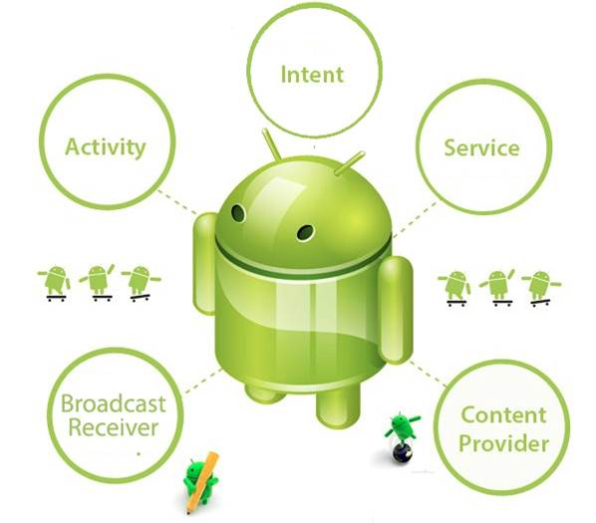
Activity : Important Building Block
May & June 2012 Recruiting Plan
Recruit 70 “Best Fit” Consulting Employees
Build out a Marketing team dedicated to recruiting
Formalize training program for new recruiters
Build out fully functioning offshore recruiting team
Implement call quality feedback loops
Coach and Mentor recruiters
Improve daily efficiency for recruiting team
3

Slide 4
What is Activity?
May & June 2012 Recruiting Plan
An Activity is an application component that provides a screen with which users can interact in order to do something, such as dial the phone, take a photo, send an email, or view a map.
Each activity is given a window in which to draw its user interface.
In other words, as in .NET or vb we design windows form , similarly in android we design activity or screen.
Each screen in android is called an activity as a standard term.
Recruit 70 “Best Fit” Consulting Employees
Build out a Marketing team dedicated to recruiting
Formalize training program for new recruiters
Build out fully functioning offshore recruiting team
Implement call quality feedback loops
Coach and Mentor recruiters
Improve daily efficiency for recruiting team
© 2014 Unbounded Solutions
4

Slide 5
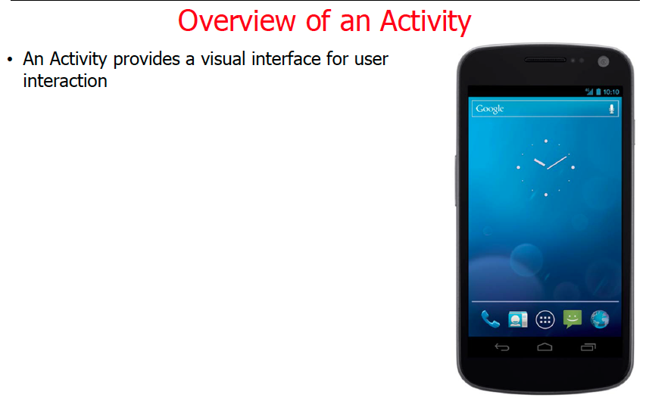
May & June 2012 Recruiting Plan
Recruit 70 “Best Fit” Consulting Employees
Build out a Marketing team dedicated to recruiting
Formalize training program for new recruiters
Build out fully functioning offshore recruiting team
Implement call quality feedback loops
Coach and Mentor recruiters
Improve daily efficiency for recruiting team
5

Slide 6
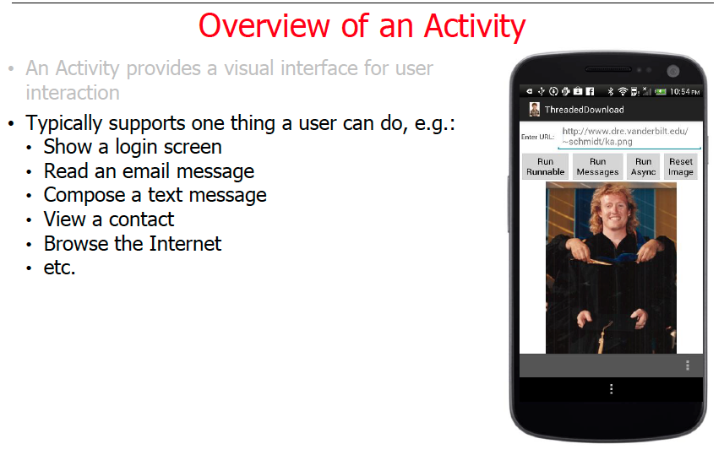
May & June 2012 Recruiting Plan
Recruit 70 “Best Fit” Consulting Employees
Build out a Marketing team dedicated to recruiting
Formalize training program for new recruiters
Build out fully functioning offshore recruiting team
Implement call quality feedback loops
Coach and Mentor recruiters
Improve daily efficiency for recruiting team
© 2014 Unbounded Solutions
6

Slide 7
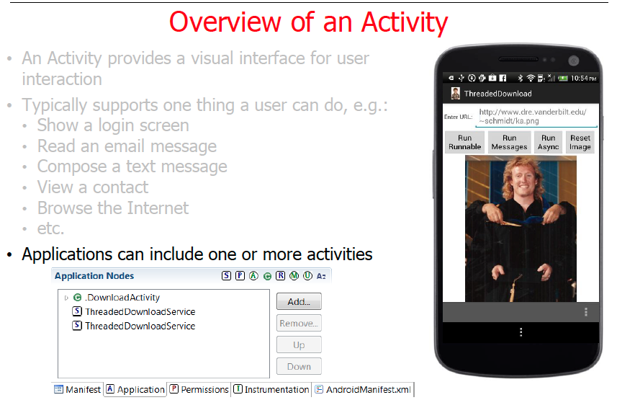
May & June 2012 Recruiting Plan
Recruit 70 “Best Fit” Consulting Employees
Build out a Marketing team dedicated to recruiting
Formalize training program for new recruiters
Build out fully functioning offshore recruiting team
Implement call quality feedback loops
Coach and Mentor recruiters
Improve daily efficiency for recruiting team
7

Slide 8
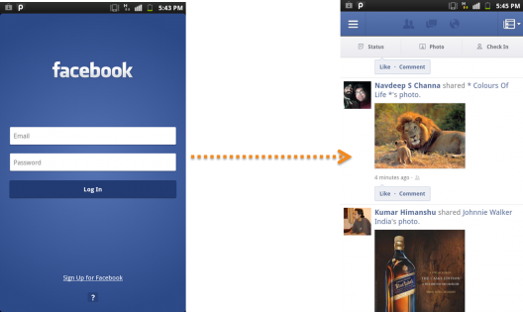
Activity is a app screen
May & June 2012 Recruiting Plan
Activities are like the pages in a website. For instance, in a Facebook app, the login screen is one activity, and the news feeds from your friends after signing in would be another one.
Recruit 70 “Best Fit” Consulting Employees
Build out a Marketing team dedicated to recruiting
Formalize training program for new recruiters
Build out fully functioning offshore recruiting team
Implement call quality feedback loops
Coach and Mentor recruiters
Improve daily efficiency for recruiting team
© 2014 Unbounded Solutions
8

Slide 9
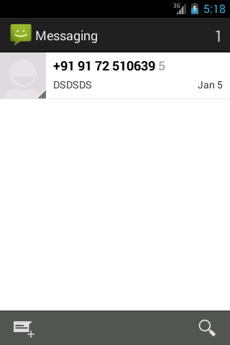
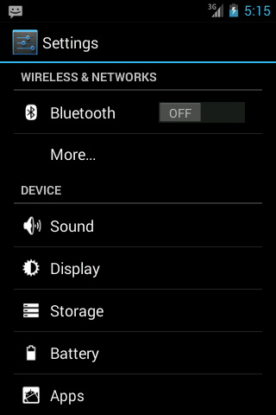
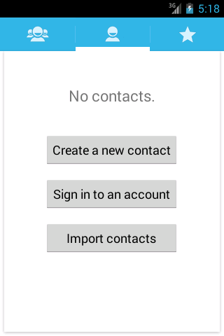

Activity is a app screen
May & June 2012 Recruiting Plan
Main or Launcher Activity
Recruit 70 “Best Fit” Consulting Employees
Build out a Marketing team dedicated to recruiting
Formalize training program for new recruiters
Build out fully functioning offshore recruiting team
Implement call quality feedback loops
Coach and Mentor recruiters
Improve daily efficiency for recruiting team
© 2014 Unbounded Solutions
9

Slide 10
Multiple Activities
May & June 2012 Recruiting Plan
An application usually consists of multiple activities that are loosely bound to each other.
Typically, one activity in an application is specified as the "main" activity, which is presented to the user when launching the application for the first time.
Each activity can then start another activity in order to perform different actions.
Recruit 70 “Best Fit” Consulting Employees
Build out a Marketing team dedicated to recruiting
Formalize training program for new recruiters
Build out fully functioning offshore recruiting team
Implement call quality feedback loops
Coach and Mentor recruiters
Improve daily efficiency for recruiting team
© 2014 Unbounded Solutions
10

Slide 11
Only One Main Activity
May & June 2012 Recruiting Plan
<activity android:name="com.sevakkalpesh.ChannelLive.MainActivity"
android:label="@string/app_name" >
<intent-filter>
<action android:name="android.intent.action.MAIN" /> <category android:name="android.intent.category.LAUNCHER" />
</intent-filter>
</activity>
<activity android:name=“.Activity2”></activity>
Recruit 70 “Best Fit” Consulting Employees
Build out a Marketing team dedicated to recruiting
Formalize training program for new recruiters
Build out fully functioning offshore recruiting team
Implement call quality feedback loops
Coach and Mentor recruiters
Improve daily efficiency for recruiting team
© 2014 Unbounded Solutions
11

Slide 12
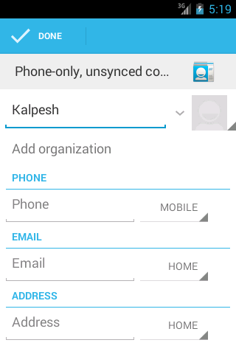
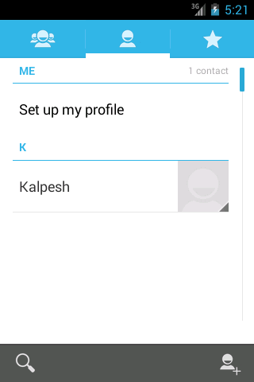
Multiple activities in Contacts App
May & June 2012 Recruiting Plan
Recruit 70 “Best Fit” Consulting Employees
Build out a Marketing team dedicated to recruiting
Formalize training program for new recruiters
Build out fully functioning offshore recruiting team
Implement call quality feedback loops
Coach and Mentor recruiters
Improve daily efficiency for recruiting team
Activity 1 (MAIN)
ACTIVITY 2
ACTIVITY 3
© 2014 Unbounded Solutions
12

Slide 13
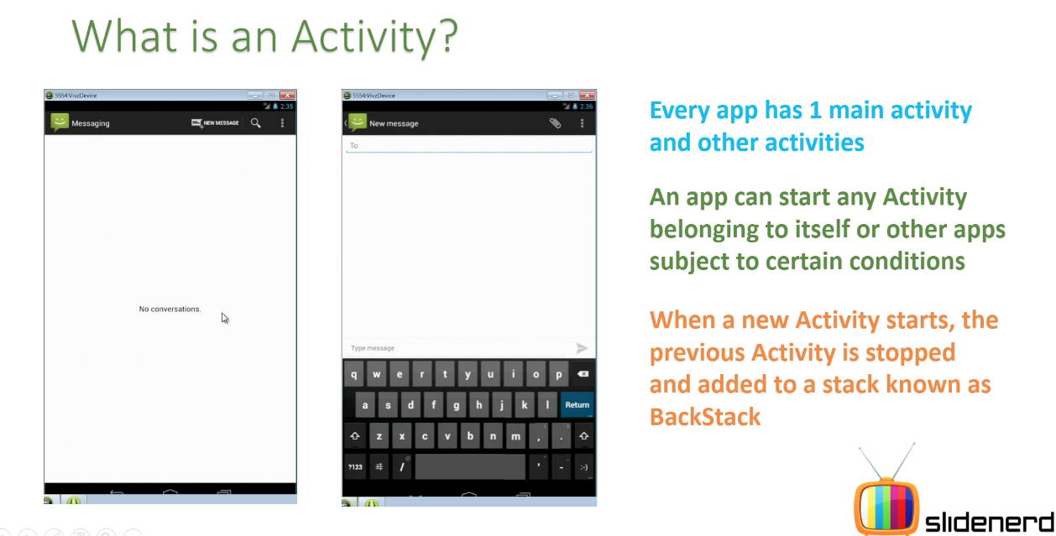
Activity is a app screen
May & June 2012 Recruiting Plan
Recruit 70 “Best Fit” Consulting Employees
Build out a Marketing team dedicated to recruiting
Formalize training program for new recruiters
Build out fully functioning offshore recruiting team
Implement call quality feedback loops
Coach and Mentor recruiters
Improve daily efficiency for recruiting team
© 2014 Unbounded Solutions
13

Slide 14
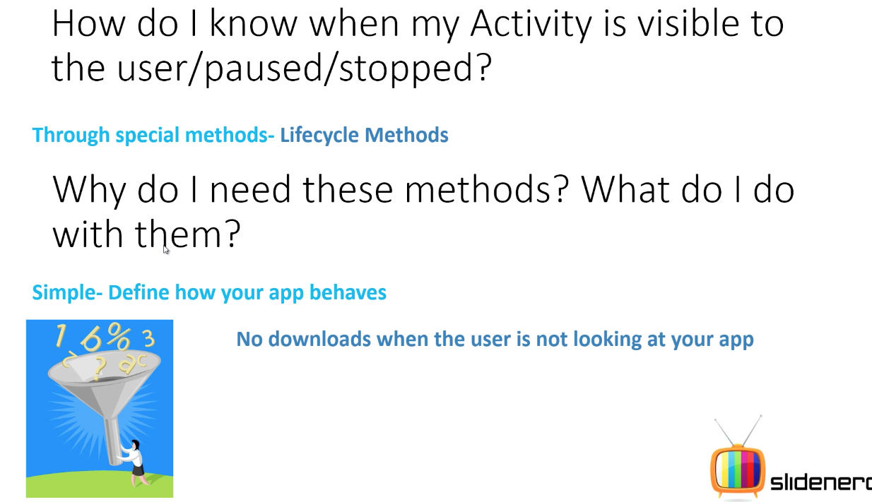
Activity is a app screen
May & June 2012 Recruiting Plan
Recruit 70 “Best Fit” Consulting Employees
Build out a Marketing team dedicated to recruiting
Formalize training program for new recruiters
Build out fully functioning offshore recruiting team
Implement call quality feedback loops
Coach and Mentor recruiters
Improve daily efficiency for recruiting team
© 2014 Unbounded Solutions
14

Slide 15
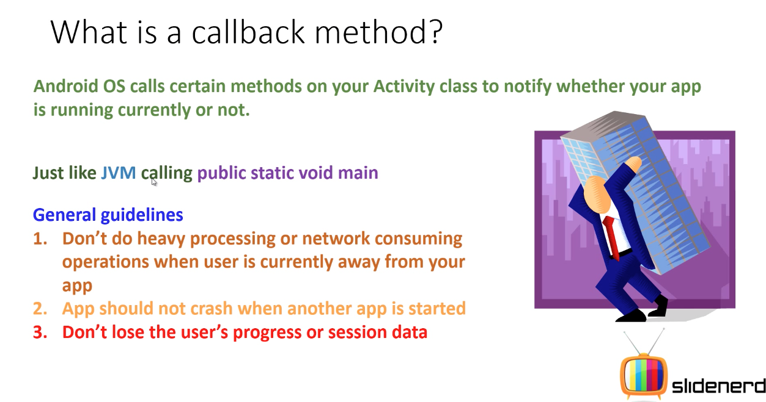
Activity is a app screen
May & June 2012 Recruiting Plan
Recruit 70 “Best Fit” Consulting Employees
Build out a Marketing team dedicated to recruiting
Formalize training program for new recruiters
Build out fully functioning offshore recruiting team
Implement call quality feedback loops
Coach and Mentor recruiters
Improve daily efficiency for recruiting team
© 2014 Unbounded Solutions
15

Slide 16
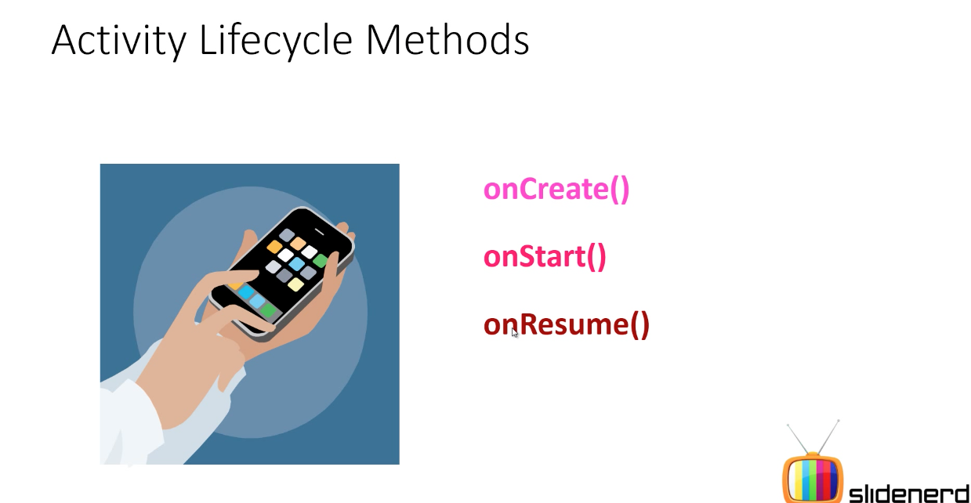
Application Launched
May & June 2012 Recruiting Plan
Recruit 70 “Best Fit” Consulting Employees
Build out a Marketing team dedicated to recruiting
Formalize training program for new recruiters
Build out fully functioning offshore recruiting team
Implement call quality feedback loops
Coach and Mentor recruiters
Improve daily efficiency for recruiting team
© 2014 Unbounded Solutions
16

Slide 17
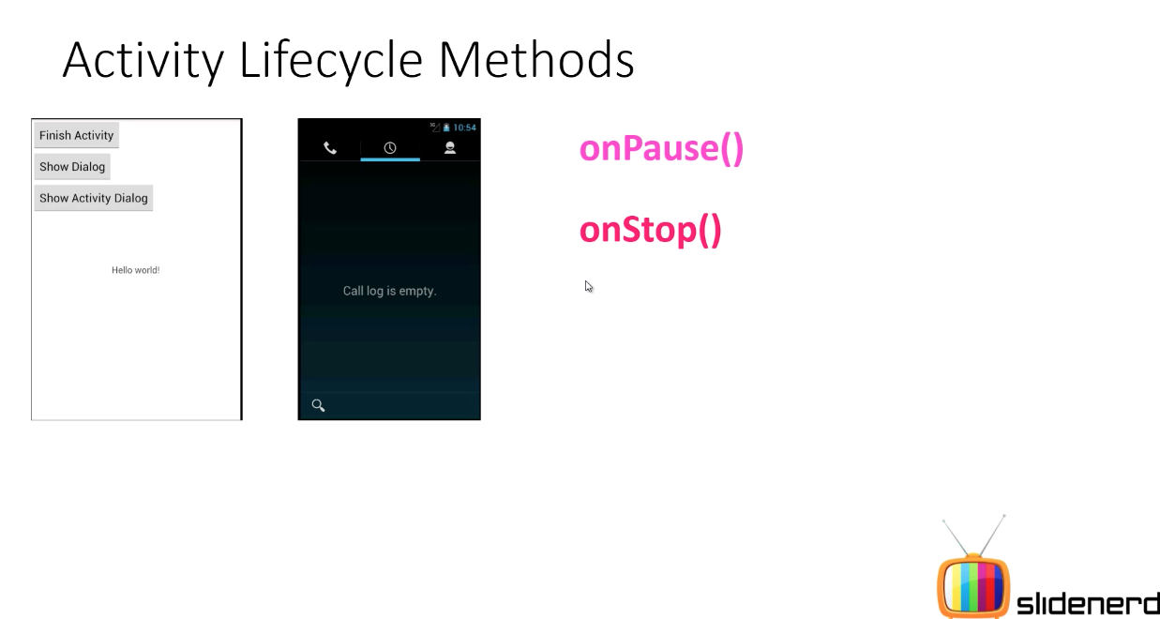
Other App Started
May & June 2012 Recruiting Plan
Recruit 70 “Best Fit” Consulting Employees
Build out a Marketing team dedicated to recruiting
Formalize training program for new recruiters
Build out fully functioning offshore recruiting team
Implement call quality feedback loops
Coach and Mentor recruiters
Improve daily efficiency for recruiting team
© 2014 Unbounded Solutions
17

Slide 18
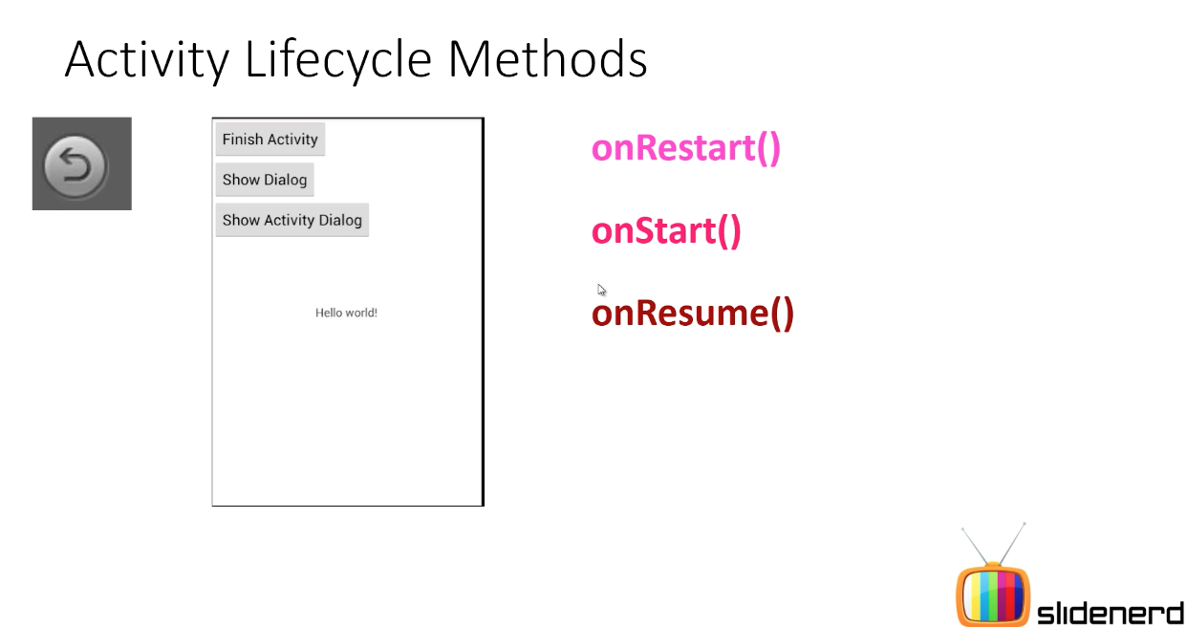
App Started Again
May & June 2012 Recruiting Plan
Recruit 70 “Best Fit” Consulting Employees
Build out a Marketing team dedicated to recruiting
Formalize training program for new recruiters
Build out fully functioning offshore recruiting team
Implement call quality feedback loops
Coach and Mentor recruiters
Improve daily efficiency for recruiting team
© 2014 Unbounded Solutions
18

Slide 19
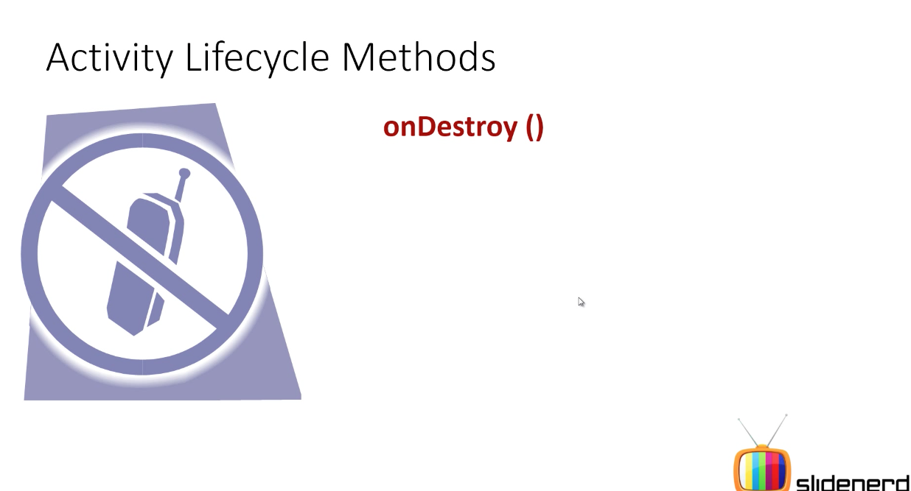
Other App Started
May & June 2012 Recruiting Plan
Recruit 70 “Best Fit” Consulting Employees
Build out a Marketing team dedicated to recruiting
Formalize training program for new recruiters
Build out fully functioning offshore recruiting team
Implement call quality feedback loops
Coach and Mentor recruiters
Improve daily efficiency for recruiting team
Terminated programmatically
No instance of app running
© 2014 Unbounded Solutions
19

Slide 20
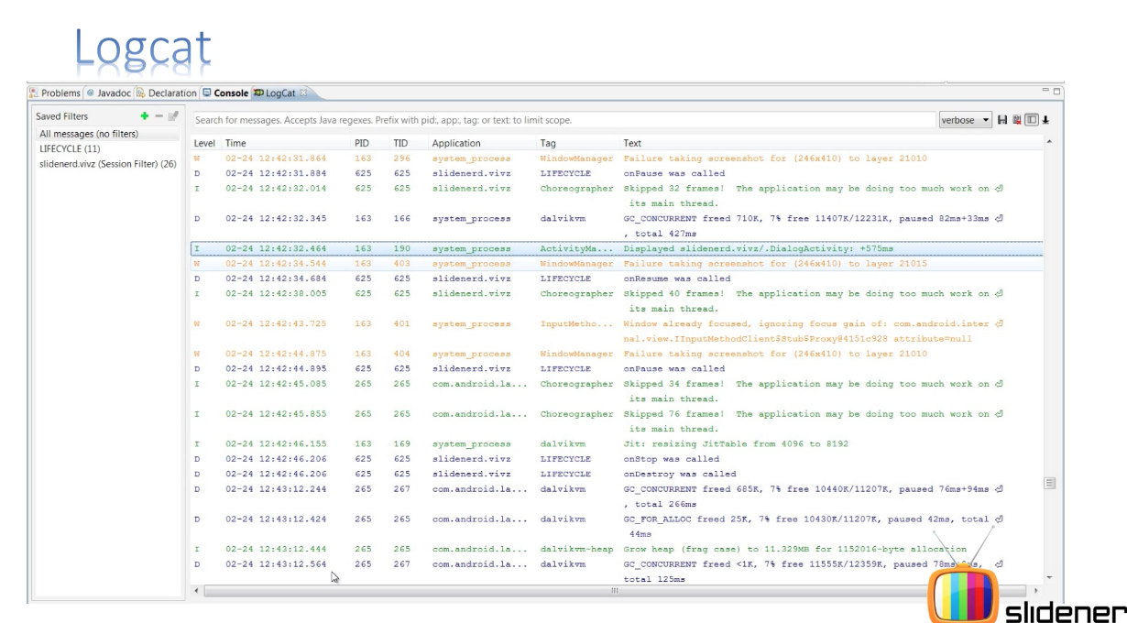
Other App Started
May & June 2012 Recruiting Plan
Recruit 70 “Best Fit” Consulting Employees
Build out a Marketing team dedicated to recruiting
Formalize training program for new recruiters
Build out fully functioning offshore recruiting team
Implement call quality feedback loops
Coach and Mentor recruiters
Improve daily efficiency for recruiting team
© 2014 Unbounded Solutions
20

Slide 21
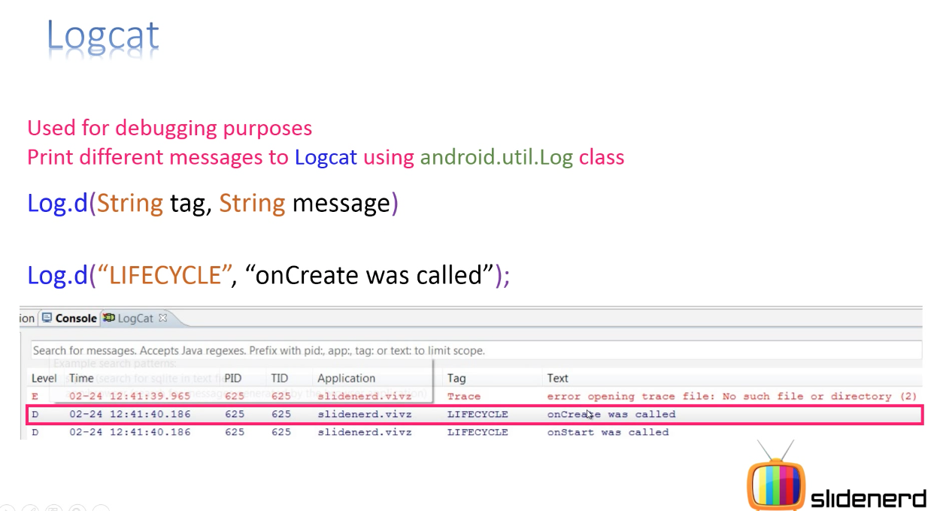
Other App Started
May & June 2012 Recruiting Plan
Recruit 70 “Best Fit” Consulting Employees
Build out a Marketing team dedicated to recruiting
Formalize training program for new recruiters
Build out fully functioning offshore recruiting team
Implement call quality feedback loops
Coach and Mentor recruiters
Improve daily efficiency for recruiting team
© 2014 Unbounded Solutions
21

Slide 22
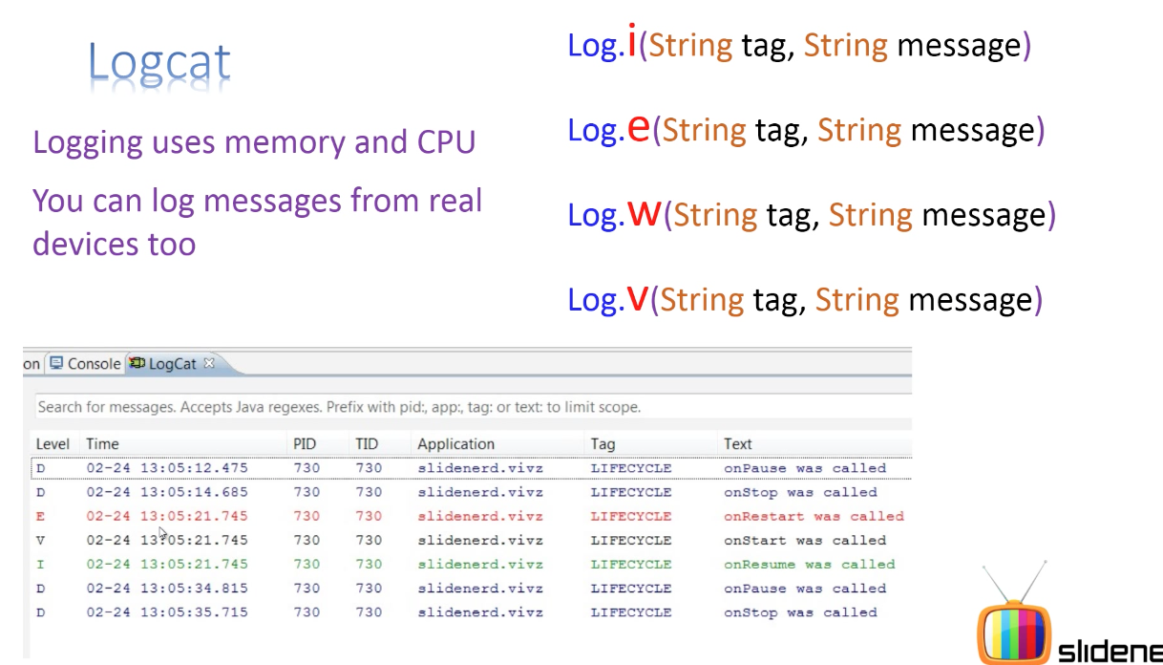
Other App Started
May & June 2012 Recruiting Plan
Recruit 70 “Best Fit” Consulting Employees
Build out a Marketing team dedicated to recruiting
Formalize training program for new recruiters
Build out fully functioning offshore recruiting team
Implement call quality feedback loops
Coach and Mentor recruiters
Improve daily efficiency for recruiting team
© 2014 Unbounded Solutions
22

Slide 23

Topic #1
May & June 2012 Recruiting Plan
Recruit 70 “Best Fit” Consulting Employees
Build out a Marketing team dedicated to recruiting
Formalize training program for new recruiters
Build out fully functioning offshore recruiting team
Implement call quality feedback loops
Coach and Mentor recruiters
Improve daily efficiency for recruiting team
Activity States and Lifecycle
© 2014 Unbounded Solutions
23

Slide 24
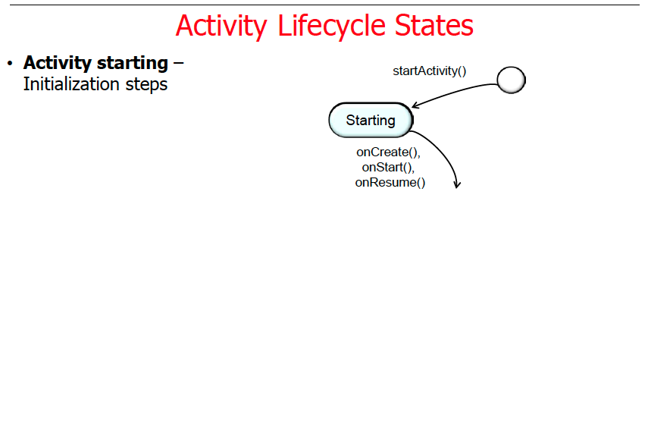
May & June 2012 Recruiting Plan
© 2014 Unbounded Solutions
24

Slide 25
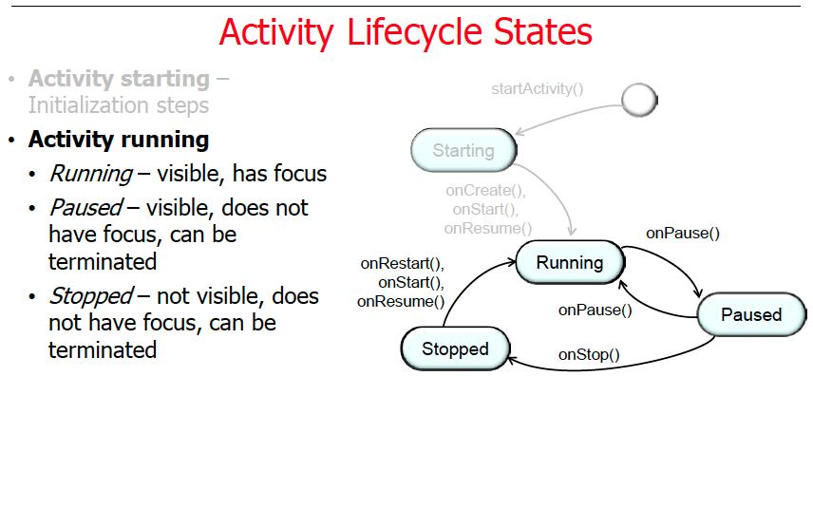
May & June 2012 Recruiting Plan
© 2014 Unbounded Solutions
25

Slide 26
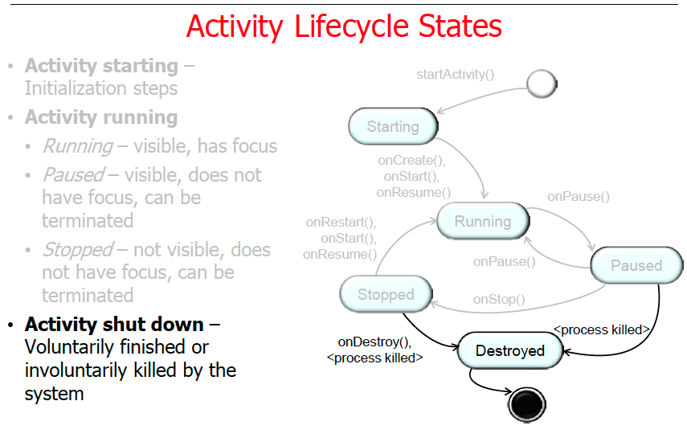
May & June 2012 Recruiting Plan
© 2014 Unbounded Solutions
26

Slide 27
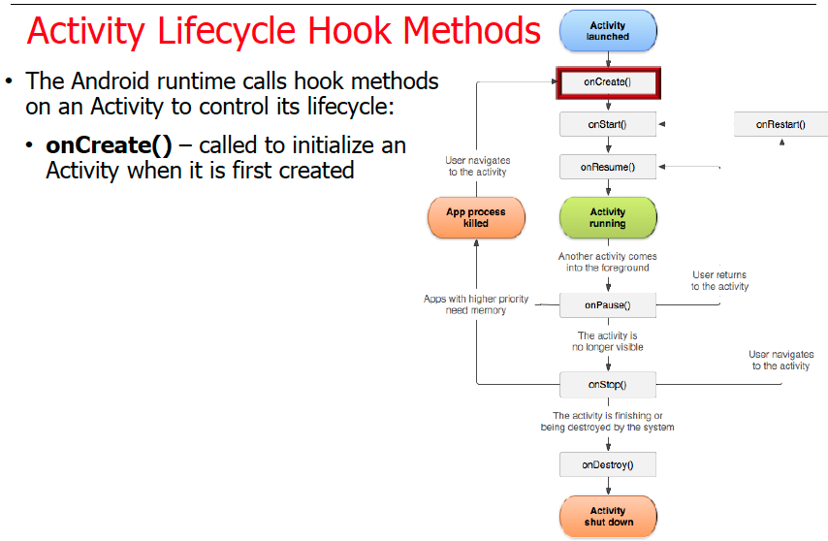
May & June 2012 Recruiting Plan
© 2014 Unbounded Solutions
27

Slide 28
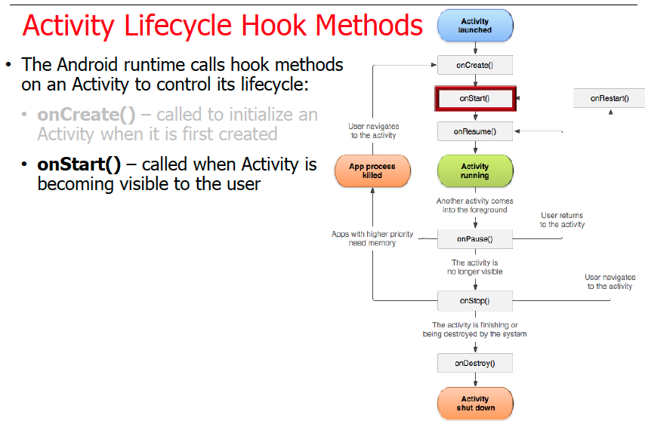
May & June 2012 Recruiting Plan
© 2014 Unbounded Solutions
28

Slide 29
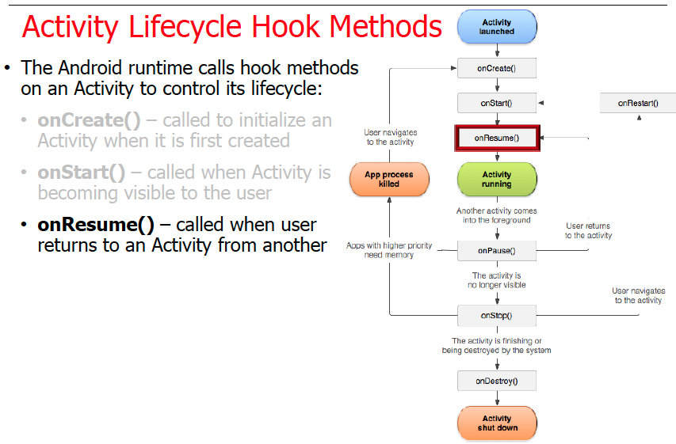
May & June 2012 Recruiting Plan
© 2014 Unbounded Solutions
29

Slide 30
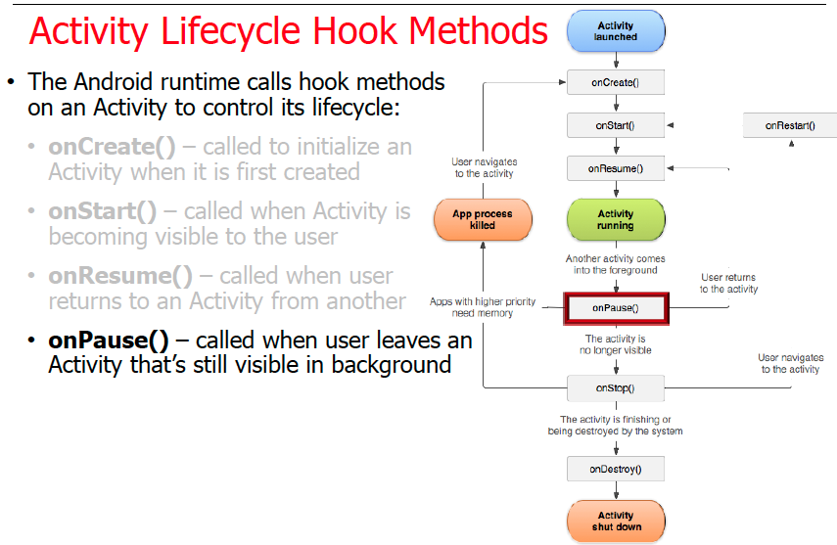
May & June 2012 Recruiting Plan
© 2014 Unbounded Solutions
30

Slide 31
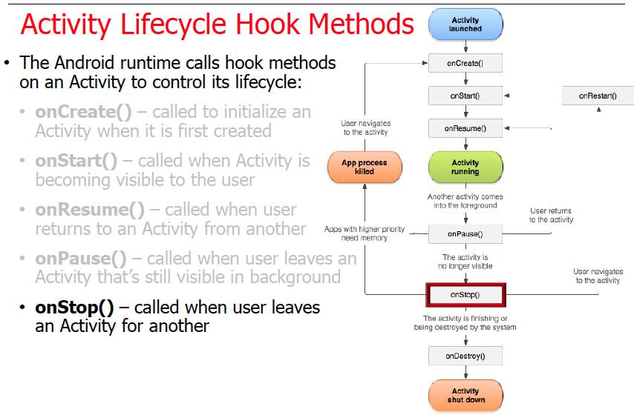
May & June 2012 Recruiting Plan
© 2014 Unbounded Solutions
31

Slide 32
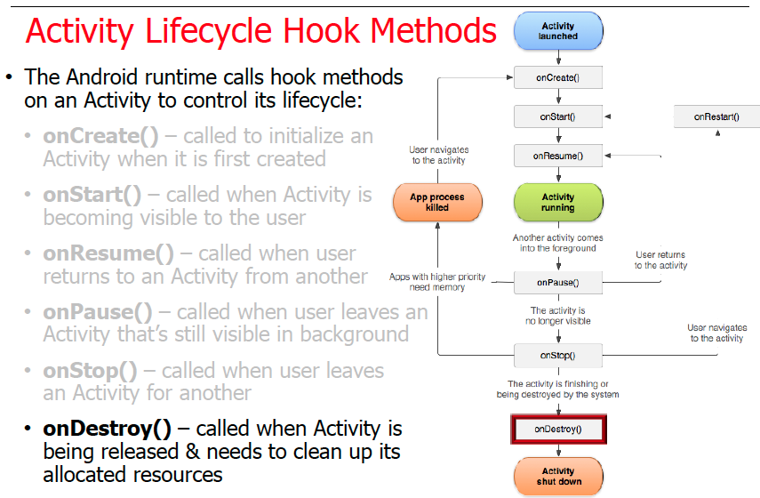
May & June 2012 Recruiting Plan
© 2014 Unbounded Solutions
32

Slide 33
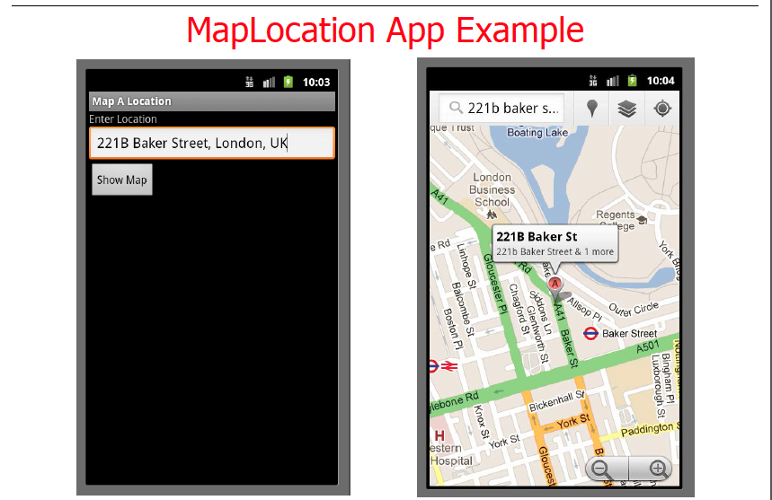
May & June 2012 Recruiting Plan
© 2014 Unbounded Solutions
33

Slide 34
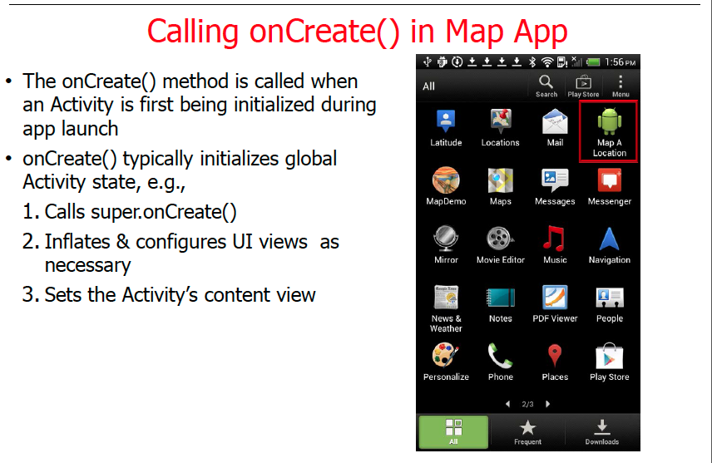
May & June 2012 Recruiting Plan
© 2014 Unbounded Solutions
34

Slide 35
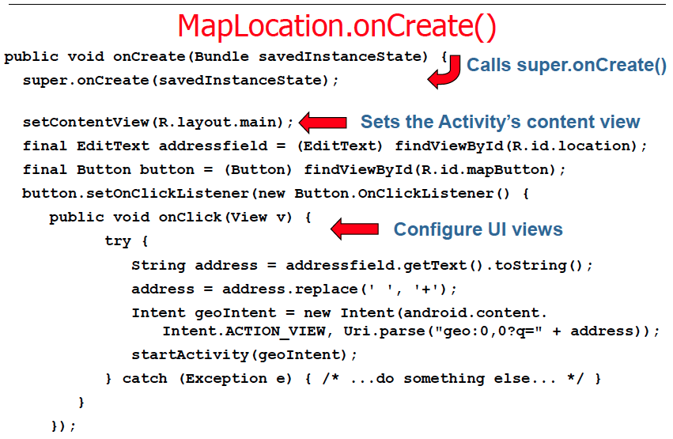
May & June 2012 Recruiting Plan
© 2014 Unbounded Solutions
35

Slide 36
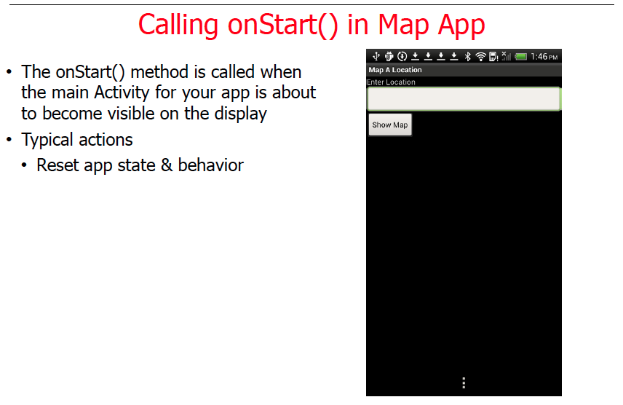
May & June 2012 Recruiting Plan
© 2014 Unbounded Solutions
36

Slide 37
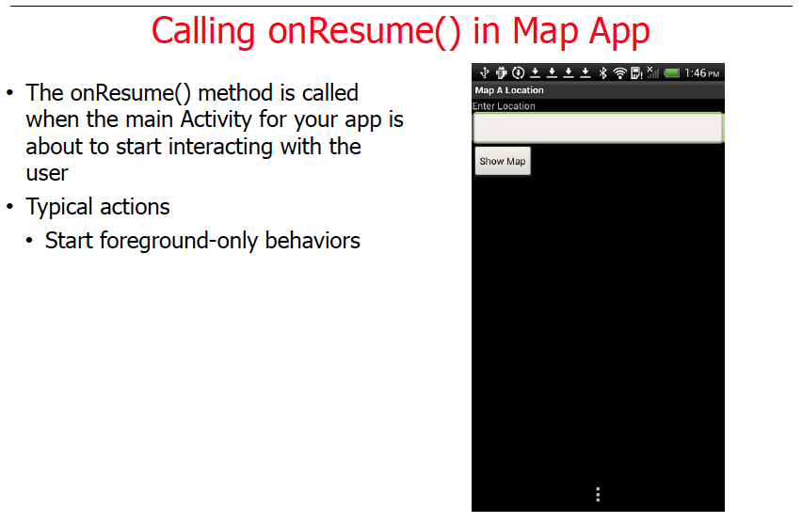
May & June 2012 Recruiting Plan
© 2014 Unbounded Solutions
37

Slide 38
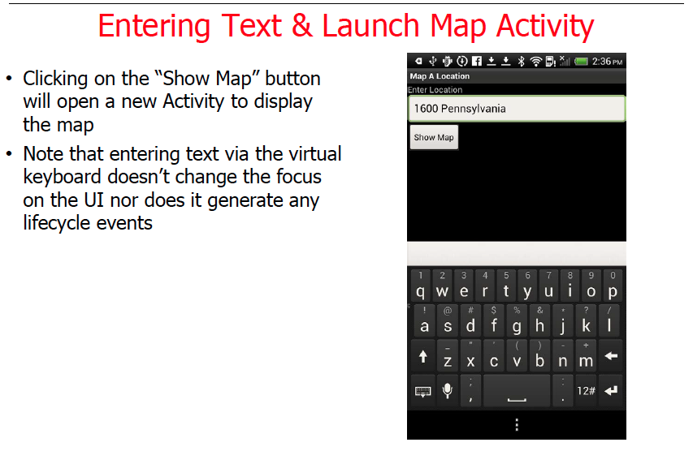
May & June 2012 Recruiting Plan
© 2014 Unbounded Solutions
38

Slide 39
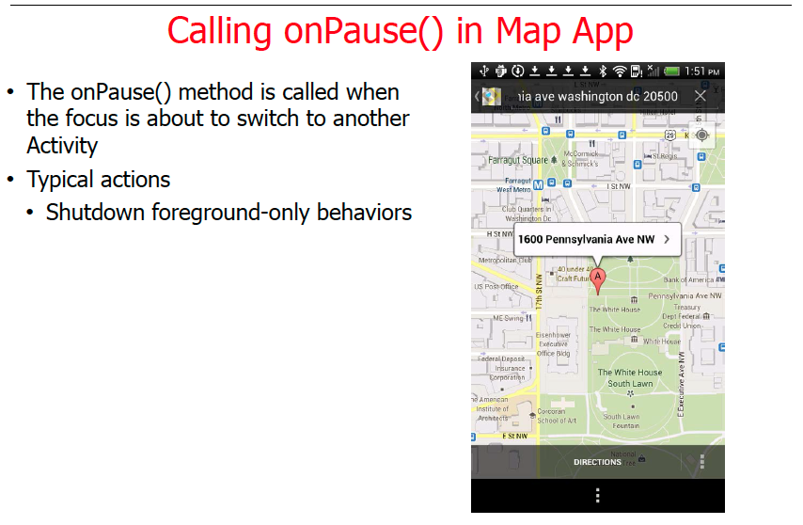
May & June 2012 Recruiting Plan
© 2014 Unbounded Solutions
39

Slide 40
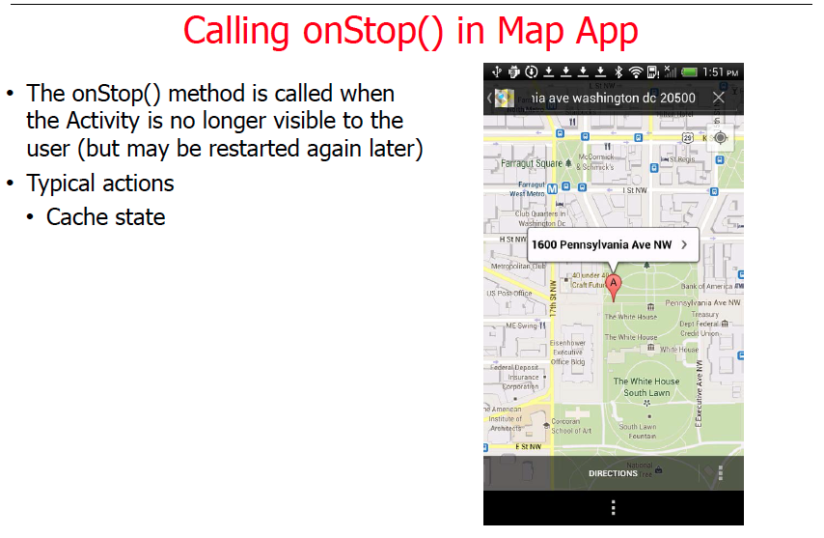
May & June 2012 Recruiting Plan
© 2014 Unbounded Solutions
40

Slide 41
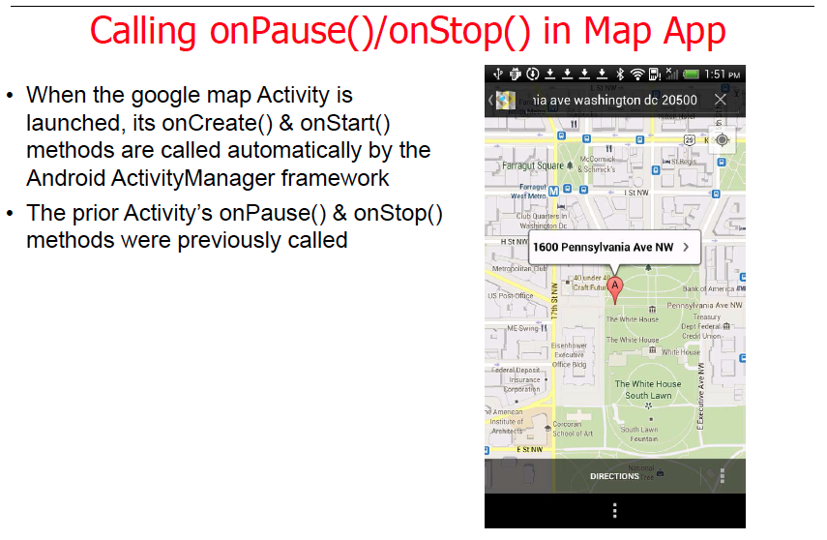
May & June 2012 Recruiting Plan
© 2014 Unbounded Solutions
41

Slide 42
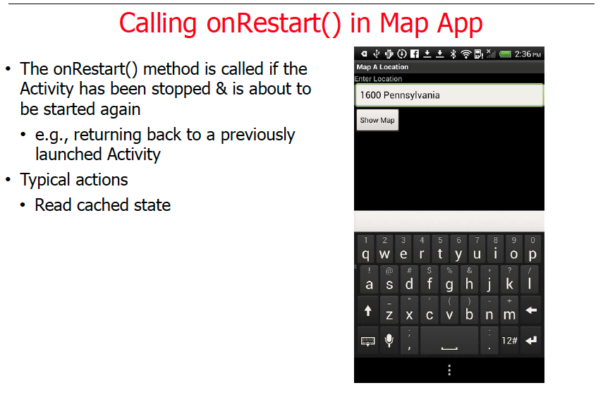
May & June 2012 Recruiting Plan
© 2014 Unbounded Solutions
42

Slide 43
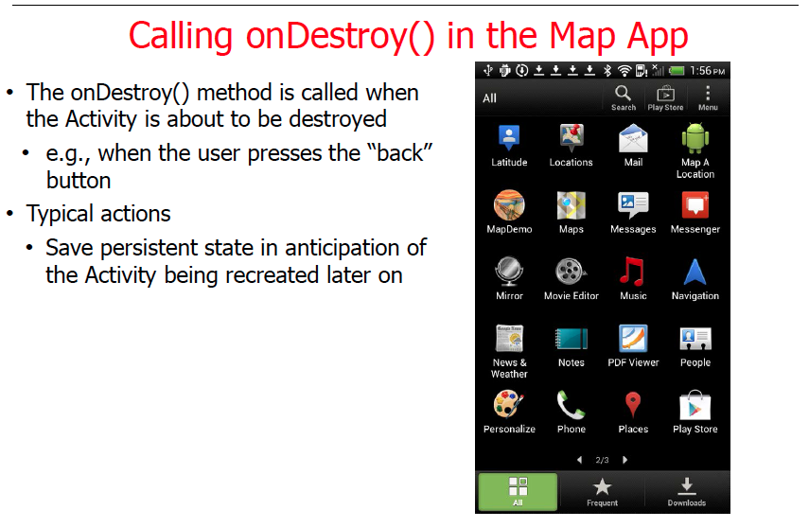
May & June 2012 Recruiting Plan
© 2014 Unbounded Solutions
43

Slide 44
Topic #2
May & June 2012 Recruiting Plan
Recruit 70 “Best Fit” Consulting Employees
Build out a Marketing team dedicated to recruiting
Formalize training program for new recruiters
Build out fully functioning offshore recruiting team
Implement call quality feedback loops
Coach and Mentor recruiters
Improve daily efficiency for recruiting team
Task and Back Stack
© 2014 Unbounded Solutions
44

Slide 45
Tasks and Back Stack
May & June 2012 Recruiting Plan
An application usually contains multiple activities.
Each activity should be designed around a specific kind of action the user can perform and can start other activities.
For example, an email application might have one activity to show a list of new email. When the user selects an email, a new activity opens to view that email
An activity can even start activities that exist in other applications on the device.
Recruit 70 “Best Fit” Consulting Employees
Build out a Marketing team dedicated to recruiting
Formalize training program for new recruiters
Build out fully functioning offshore recruiting team
Implement call quality feedback loops
Coach and Mentor recruiters
Improve daily efficiency for recruiting team
© 2014 Unbounded Solutions
45

Slide 46
Overview
May & June 2012 Recruiting Plan
An activity from another application that declares itself to handle this kind of intent then opens. In this case, the intent is to send an email, so an email application's "compose" activity starts
When the email is sent, your activity resumes and it seems as if the email activity was part of your application.
Even though the activities may be from different applications, Android maintains this seamless user experience by keeping both activities in the same task.
Recruit 70 “Best Fit” Consulting Employees
Build out a Marketing team dedicated to recruiting
Formalize training program for new recruiters
Build out fully functioning offshore recruiting team
Implement call quality feedback loops
Coach and Mentor recruiters
Improve daily efficiency for recruiting team
© 2014 Unbounded Solutions
46

Slide 47
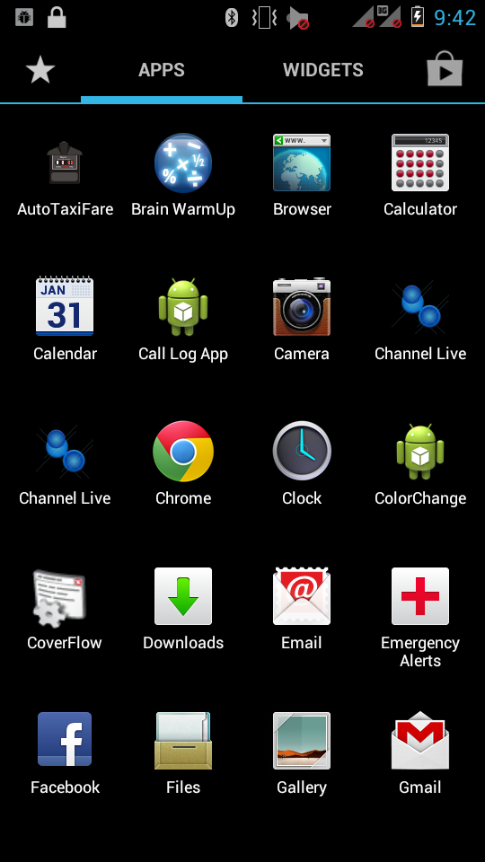
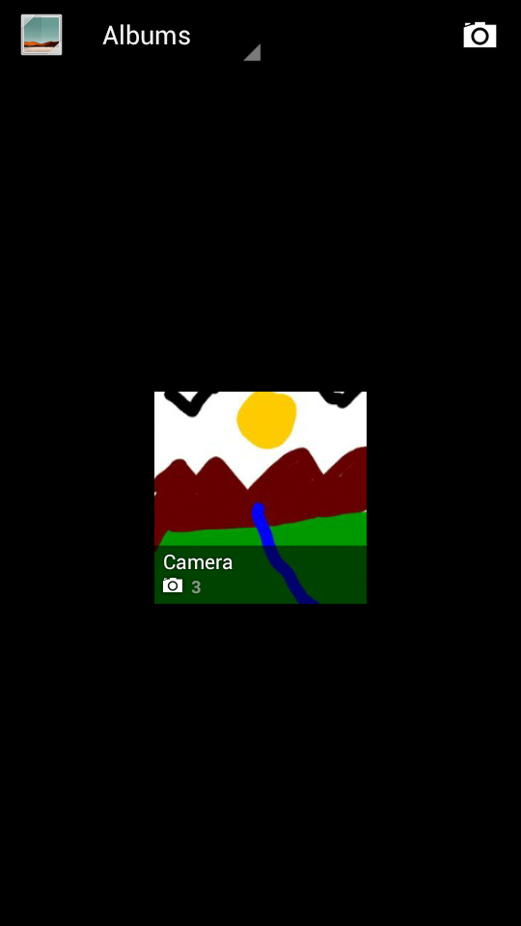
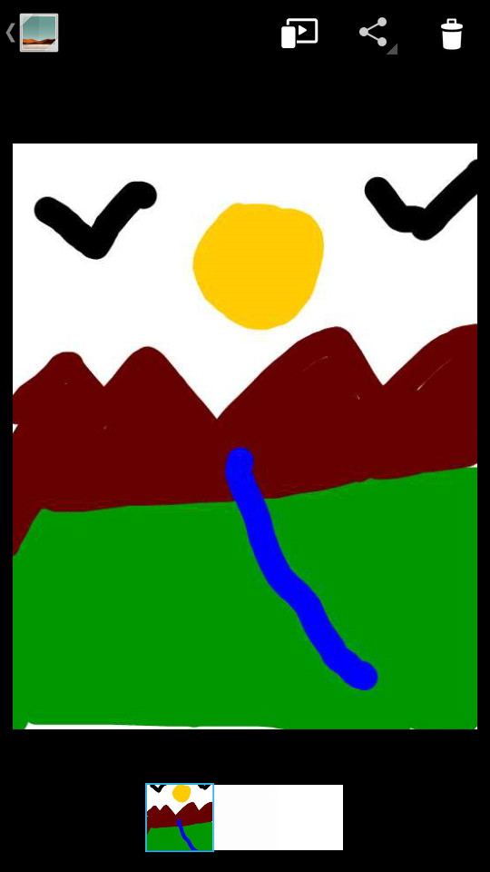
Example
May & June 2012 Recruiting Plan
Recruit 70 “Best Fit” Consulting Employees
Build out a Marketing team dedicated to recruiting
Formalize training program for new recruiters
Build out fully functioning offshore recruiting team
Implement call quality feedback loops
Coach and Mentor recruiters
Improve daily efficiency for recruiting team
HOME SCREEN
ACTIVITY 1
ACTIVITY 2
© 2014 Unbounded Solutions
47

Slide 48
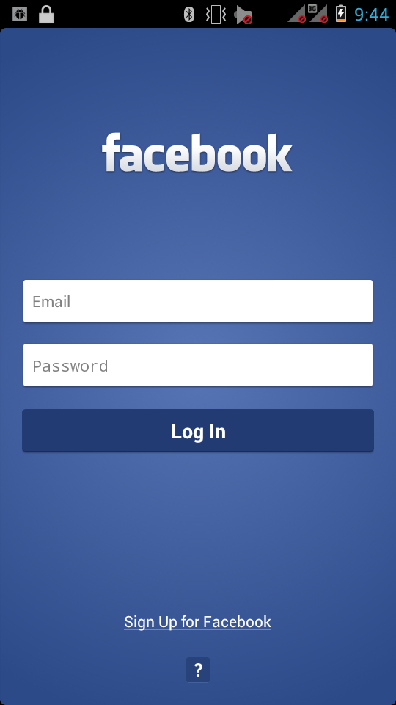
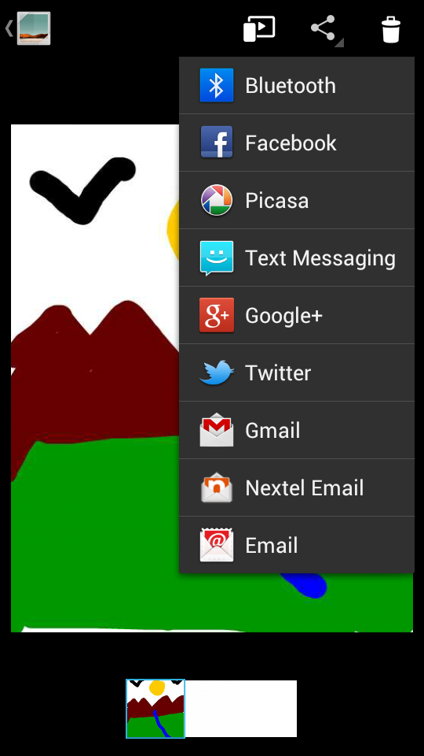

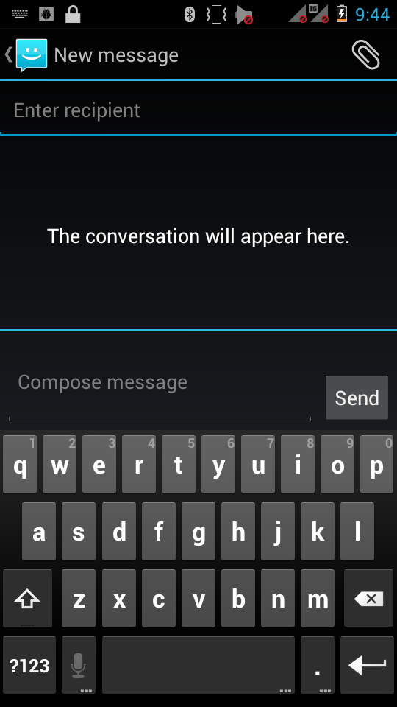
A TASK : Inter-App Interaction
May & June 2012 Recruiting Plan
External APP
Recruit 70 “Best Fit” Consulting Employees
Build out a Marketing team dedicated to recruiting
Formalize training program for new recruiters
Build out fully functioning offshore recruiting team
Implement call quality feedback loops
Coach and Mentor recruiters
Improve daily efficiency for recruiting team
Activity 3
© 2014 Unbounded Solutions
48

Slide 49
ATask?
May & June 2012 Recruiting Plan
Recruit 70 “Best Fit” Consulting Employees
Build out a Marketing team dedicated to recruiting
Formalize training program for new recruiters
Build out fully functioning offshore recruiting team
Implement call quality feedback loops
Coach and Mentor recruiters
Improve daily efficiency for recruiting team
ACTIVITY 1
ACTIVITY 2
EXTERNAL APPLICATION
© 2014 Unbounded Solutions
49

Slide 50
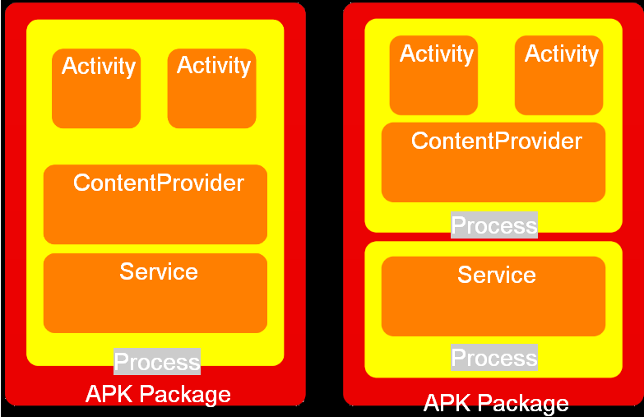
A TASK
May & June 2012 Recruiting Plan
Recruit 70 “Best Fit” Consulting Employees
Build out a Marketing team dedicated to recruiting
Formalize training program for new recruiters
Build out fully functioning offshore recruiting team
Implement call quality feedback loops
Coach and Mentor recruiters
Improve daily efficiency for recruiting team
© 2014 Unbounded Solutions
50

Slide 51
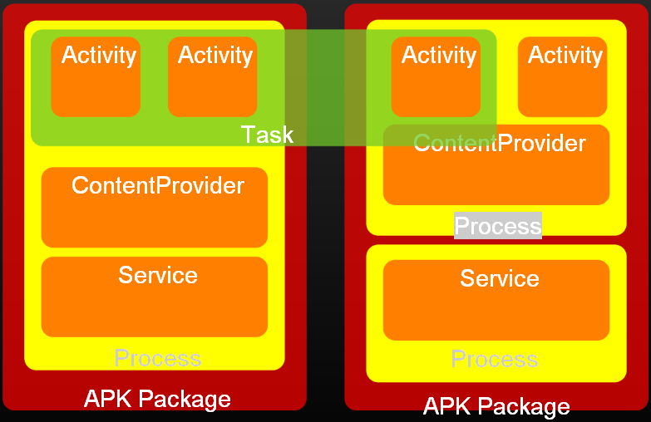
A TASK
May & June 2012 Recruiting Plan
Recruit 70 “Best Fit” Consulting Employees
Build out a Marketing team dedicated to recruiting
Formalize training program for new recruiters
Build out fully functioning offshore recruiting team
Implement call quality feedback loops
Coach and Mentor recruiters
Improve daily efficiency for recruiting team
© 2014 Unbounded Solutions
51

Slide 52
What is a Task?
May & June 2012 Recruiting Plan
A task is a collection of activities that users interact with when performing a certain job.
The activities are arranged in a stack (the "back stack"), in the order in which each activity is opened.
So now, what is a back stack?
Recruit 70 “Best Fit” Consulting Employees
Build out a Marketing team dedicated to recruiting
Formalize training program for new recruiters
Build out fully functioning offshore recruiting team
Implement call quality feedback loops
Coach and Mentor recruiters
Improve daily efficiency for recruiting team
© 2014 Unbounded Solutions
52

Slide 53
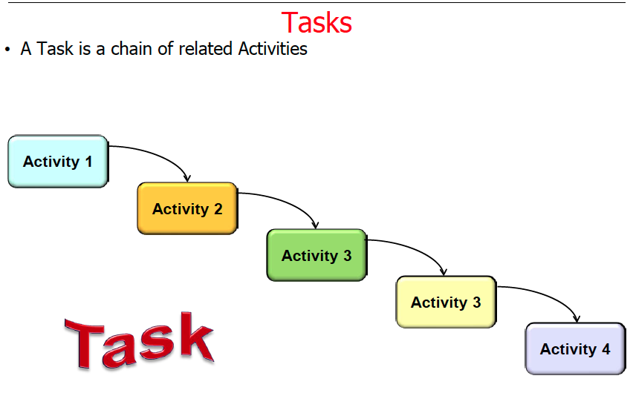
May & June 2012 Recruiting Plan
Recruit 70 “Best Fit” Consulting Employees
Build out a Marketing team dedicated to recruiting
Formalize training program for new recruiters
Build out fully functioning offshore recruiting team
Implement call quality feedback loops
Coach and Mentor recruiters
Improve daily efficiency for recruiting team
© 2014 Unbounded Solutions
53

Slide 54
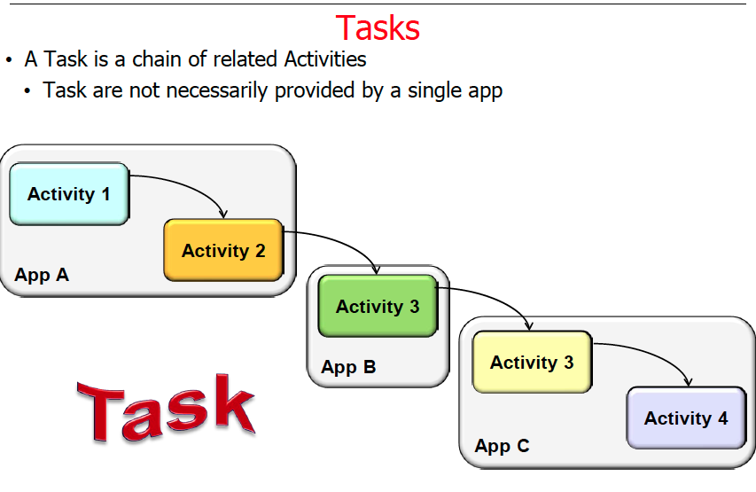
May & June 2012 Recruiting Plan
Recruit 70 “Best Fit” Consulting Employees
Build out a Marketing team dedicated to recruiting
Formalize training program for new recruiters
Build out fully functioning offshore recruiting team
Implement call quality feedback loops
Coach and Mentor recruiters
Improve daily efficiency for recruiting team
© 2014 Unbounded Solutions
54

Slide 55

May & June 2012 Recruiting Plan
Recruit 70 “Best Fit” Consulting Employees
Build out a Marketing team dedicated to recruiting
Formalize training program for new recruiters
Build out fully functioning offshore recruiting team
Implement call quality feedback loops
Coach and Mentor recruiters
Improve daily efficiency for recruiting team
© 2014 Unbounded Solutions
55

Slide 56
What is a Back-Stack?
May & June 2012 Recruiting Plan
The device Home screen is the starting place for most tasks.
When the user touches an icon in the application launcher (or a shortcut on the Home screen), that application's task comes to the foreground and the "main" activity for that application opens as the root activity in the stack.
When the current activity starts another, the new activity is pushed on the top of the stack and takes focus.
The previous activity remains in the stack, but is stopped.
When an activity stops, the system retains the current state of its user interface.
Recruit 70 “Best Fit” Consulting Employees
Build out a Marketing team dedicated to recruiting
Formalize training program for new recruiters
Build out fully functioning offshore recruiting team
Implement call quality feedback loops
Coach and Mentor recruiters
Improve daily efficiency for recruiting team
© 2014 Unbounded Solutions
56

Slide 57
What is a Back-Stack?
May & June 2012 Recruiting Plan
When the user presses the Back button, the current activity is popped from the top of the stack (the activity is destroyed) and the previous activity resumes (the previous state of its UI is restored).
Activities in the stack are never rearranged, only pushed and popped from the stack—pushed onto the stack when started by the current activity and popped off when the user leaves it using the Back button.
As such, the back stack operates as a "last in, first out" object structure
Recruit 70 “Best Fit” Consulting Employees
Build out a Marketing team dedicated to recruiting
Formalize training program for new recruiters
Build out fully functioning offshore recruiting team
Implement call quality feedback loops
Coach and Mentor recruiters
Improve daily efficiency for recruiting team
© 2014 Unbounded Solutions
57

Slide 58
Stack of Activities
May & June 2012 Recruiting Plan
Recruit 70 “Best Fit” Consulting Employees
Build out a Marketing team dedicated to recruiting
Formalize training program for new recruiters
Build out fully functioning offshore recruiting team
Implement call quality feedback loops
Coach and Mentor recruiters
Improve daily efficiency for recruiting team
ACTIVITY 3
ACTIVITY 2
PUSH
ACTIVITY 1
POP
ROOT ACTIVITY (MAIN)
© 2014 Unbounded Solutions
58

Slide 59
Contacts App Back-Stack
May & June 2012 Recruiting Plan
Recruit 70 “Best Fit” Consulting Employees
Build out a Marketing team dedicated to recruiting
Formalize training program for new recruiters
Build out fully functioning offshore recruiting team
Implement call quality feedback loops
Coach and Mentor recruiters
Improve daily efficiency for recruiting team
Activity 1 (MAIN)
ACTIVITY 2
ACTIVITY 3
© 2014 Unbounded Solutions
59

Slide 60

Back-Stack diagram
May & June 2012 Recruiting Plan
A representation of how each new activity in a task adds an item to the back stack. When the user presses the Back button, the current activity is destroyed and the previous activity resumes.
Recruit 70 “Best Fit” Consulting Employees
Build out a Marketing team dedicated to recruiting
Formalize training program for new recruiters
Build out fully functioning offshore recruiting team
Implement call quality feedback loops
Coach and Mentor recruiters
Improve daily efficiency for recruiting team
© 2014 Unbounded Solutions
60

Slide 61

May & June 2012 Recruiting Plan
Recruit 70 “Best Fit” Consulting Employees
Build out a Marketing team dedicated to recruiting
Formalize training program for new recruiters
Build out fully functioning offshore recruiting team
Implement call quality feedback loops
Coach and Mentor recruiters
Improve daily efficiency for recruiting team
© 2014 Unbounded Solutions
61

Slide 62
Default behavior for activities and tasks: 1
May & June 2012 Recruiting Plan
When Activity A starts Activity B, Activity A is stopped, but the system retains its state (such as scroll position and text entered into forms).
If the user presses the Back button while in Activity B, Activity A resumes with its state restored.
Recruit 70 “Best Fit” Consulting Employees
Build out a Marketing team dedicated to recruiting
Formalize training program for new recruiters
Build out fully functioning offshore recruiting team
Implement call quality feedback loops
Coach and Mentor recruiters
Improve daily efficiency for recruiting team
© 2014 Unbounded Solutions
62

Slide 63



Behavior: 1
May & June 2012 Recruiting Plan
Recruit 70 “Best Fit” Consulting Employees
Build out a Marketing team dedicated to recruiting
Formalize training program for new recruiters
Build out fully functioning offshore recruiting team
Implement call quality feedback loops
Coach and Mentor recruiters
Improve daily efficiency for recruiting team
Join Selected
© 2014 Unbounded Solutions
63

Slide 64

Behavior: 1
May & June 2012 Recruiting Plan
Recruit 70 “Best Fit” Consulting Employees
Build out a Marketing team dedicated to recruiting
Formalize training program for new recruiters
Build out fully functioning offshore recruiting team
Implement call quality feedback loops
Coach and Mentor recruiters
Improve daily efficiency for recruiting team
Back key is pressed: Values are restored in a task
© 2014 Unbounded Solutions
64

Slide 65
Default behavior for activities and tasks: 2
May & June 2012 Recruiting Plan
When the user leaves a task by pressing the Home button, the current activity is stopped and its task goes into the background.
The system retains the state of every activity in the task.
If the user later resumes the task by selecting the launcher icon that began the task, the task comes to the foreground and resumes the activity at the top of the stack
Recruit 70 “Best Fit” Consulting Employees
Build out a Marketing team dedicated to recruiting
Formalize training program for new recruiters
Build out fully functioning offshore recruiting team
Implement call quality feedback loops
Coach and Mentor recruiters
Improve daily efficiency for recruiting team
© 2014 Unbounded Solutions
65

Slide 66


Behavior: 2
May & June 2012 Recruiting Plan
Recruit 70 “Best Fit” Consulting Employees
Build out a Marketing team dedicated to recruiting
Formalize training program for new recruiters
Build out fully functioning offshore recruiting team
Implement call quality feedback loops
Coach and Mentor recruiters
Improve daily efficiency for recruiting team
© 2014 Unbounded Solutions
66

Slide 67
Default behavior for activities and tasks: 3
May & June 2012 Recruiting Plan
If the user presses the Back button, the current activity is popped from the stack and destroyed. The previous activity in the stack is resumed.
When an activity is destroyed, the system does not retain the activity's state.
Recruit 70 “Best Fit” Consulting Employees
Build out a Marketing team dedicated to recruiting
Formalize training program for new recruiters
Build out fully functioning offshore recruiting team
Implement call quality feedback loops
Coach and Mentor recruiters
Improve daily efficiency for recruiting team
© 2014 Unbounded Solutions
67

Slide 68

Behavior: 3
May & June 2012 Recruiting Plan
Recruit 70 “Best Fit” Consulting Employees
Build out a Marketing team dedicated to recruiting
Formalize training program for new recruiters
Build out fully functioning offshore recruiting team
Implement call quality feedback loops
Coach and Mentor recruiters
Improve daily efficiency for recruiting team
© 2014 Unbounded Solutions
68

Slide 69
Default behavior for activities and tasks: 4
May & June 2012 Recruiting Plan
Activities can be instantiated multiple times, even from other tasks.
Recruit 70 “Best Fit” Consulting Employees
Build out a Marketing team dedicated to recruiting
Formalize training program for new recruiters
Build out fully functioning offshore recruiting team
Implement call quality feedback loops
Coach and Mentor recruiters
Improve daily efficiency for recruiting team
© 2014 Unbounded Solutions
69

Slide 70
Behavior: 4
May & June 2012 Recruiting Plan
Recruit 70 “Best Fit” Consulting Employees
Build out a Marketing team dedicated to recruiting
Formalize training program for new recruiters
Build out fully functioning offshore recruiting team
Implement call quality feedback loops
Coach and Mentor recruiters
Improve daily efficiency for recruiting team
TASK 1
TASK 2
© 2014 Unbounded Solutions
70

Slide 71
Topic
May & June 2012 Recruiting Plan
Recruit 70 “Best Fit” Consulting Employees
Build out a Marketing team dedicated to recruiting
Formalize training program for new recruiters
Build out fully functioning offshore recruiting team
Implement call quality feedback loops
Coach and Mentor recruiters
Improve daily efficiency for recruiting team
Understanding
Understanding
Activity launch mode
© 2014 Unbounded Solutions
71

Slide 72
Managing Task
May & June 2012 Recruiting Plan
In this regard, the principal <activity> attributes you can use are:
taskAffinity
launchMode
allowTaskReparenting
clearTaskOnLaunch
alwaysRetainTaskState
finishOnTaskLaunch
Recruit 70 “Best Fit” Consulting Employees
Build out a Marketing team dedicated to recruiting
Formalize training program for new recruiters
Build out fully functioning offshore recruiting team
Implement call quality feedback loops
Coach and Mentor recruiters
Improve daily efficiency for recruiting team
© 2014 Unbounded Solutions
72

Slide 73
Activity Attributes
May & June 2012 Recruiting Plan
<activity android:launchMode="singleTop"
android:name="com.sevakkalpesh.ChannelLive.MainActivity"
android:label="@string/app_name" >
<intent-filter>
<action android:name="android.intent.action.MAIN" />
<category android:name="android.intent.category.LAUNCHER" />
</intent-filter>
</activity>
Recruit 70 “Best Fit” Consulting Employees
Build out a Marketing team dedicated to recruiting
Formalize training program for new recruiters
Build out fully functioning offshore recruiting team
Implement call quality feedback loops
Coach and Mentor recruiters
Improve daily efficiency for recruiting team
© 2014 Unbounded Solutions
73

Slide 74
Activity Attributes
May & June 2012 Recruiting Plan
<activity android:allowTaskReparenting=["true" | "false"]
android:alwaysRetainTaskState=["true" | "false"]
android:clearTaskOnLaunch=["true" | "false"]
android:configChanges=["mcc", "mnc", "locale",
"touchscreen", "keyboard", "keyboardHidden",
"navigation", "screenLayout", "fontScale", "uiMode",
"orientation", "screenSize", "smallestScreenSize"]
Recruit 70 “Best Fit” Consulting Employees
Build out a Marketing team dedicated to recruiting
Formalize training program for new recruiters
Build out fully functioning offshore recruiting team
Implement call quality feedback loops
Coach and Mentor recruiters
Improve daily efficiency for recruiting team
© 2014 Unbounded Solutions
74

Slide 75
Activity Attributes
May & June 2012 Recruiting Plan
android:enabled=["true" | "false"]
android:excludeFromRecents=["true" | "false"]
android:exported=["true" | "false"]
android:finishOnTaskLaunch=["true" | "false"]
android:hardwareAccelerated=["true" | "false"]
android:icon="drawable resource”
android:label="string resource »
android:launchMode=["multiple" | "singleTop" |
"singleTask" | "singleInstance"]
Recruit 70 “Best Fit” Consulting Employees
Build out a Marketing team dedicated to recruiting
Formalize training program for new recruiters
Build out fully functioning offshore recruiting team
Implement call quality feedback loops
Coach and Mentor recruiters
Improve daily efficiency for recruiting team
Allow to run from other app
Multiple instances of app
Begin only from root activity
© 2014 Unbounded Solutions
75

Slide 76
Activity Attributes
May & June 2012 Recruiting Plan
android:multiprocess=["true" | "false"]
android:name="string »
android:noHistory=["true" | "false"]
android:parentActivityName="string"
android:windowSoftInputMode=["stateUnspecified",
android:process="string »
android:screenOrientation=["unspecified" | "behind" |
"landscape" | "portrait" |
"reverseLandscape" |
Recruit 70 “Best Fit” Consulting Employees
Build out a Marketing team dedicated to recruiting
Formalize training program for new recruiters
Build out fully functioning offshore recruiting team
Implement call quality feedback loops
Coach and Mentor recruiters
Improve daily efficiency for recruiting team
© 2014 Unbounded Solutions
76

Slide 77
launchMode
May & June 2012 Recruiting Plan
android:launchMode=”standard” –
This is the default.
It creates a new instance of an activity in the task from which it was started and routes the intent to it.
You can create the same activity multiple times in the same task as well as in different tasks.
Recruit 70 “Best Fit” Consulting Employees
Build out a Marketing team dedicated to recruiting
Formalize training program for new recruiters
Build out fully functioning offshore recruiting team
Implement call quality feedback loops
Coach and Mentor recruiters
Improve daily efficiency for recruiting team
© 2014 Unbounded Solutions
77

Slide 78
launchMode
May & June 2012 Recruiting Plan
android:launchMode=”singleTop” –
In this case, if the activity already exist at the top of the task’s back stack, then the system routes the intent to it by calling the activity’s onNewIntent() method.
It does not create a new activity. With this setting, you can create multiple versions of the same activity in the same task or in different tasks but only if it does not already exist at the top of the stack.
If a new activity is created, then onNewIntent() is not called.
Recruit 70 “Best Fit” Consulting Employees
Build out a Marketing team dedicated to recruiting
Formalize training program for new recruiters
Build out fully functioning offshore recruiting team
Implement call quality feedback loops
Coach and Mentor recruiters
Improve daily efficiency for recruiting team
© 2014 Unbounded Solutions
78

Slide 79
launchMode
May & June 2012 Recruiting Plan
android:launchMode=”singleTask” –
Here, the system creates a new task with this new activity at its root.
However, if the activity already exists in another task, then the system routes the intent to that activity’s onNewIntent() method and does not create a new instance of the activity.
Only one instance of the activity can exist at a time.
If you press the BACK button and the activity is in another task then that task’s whole back stack is brought forward and put on top of the current task’s back stack.
Recruit 70 “Best Fit” Consulting Employees
Build out a Marketing team dedicated to recruiting
Formalize training program for new recruiters
Build out fully functioning offshore recruiting team
Implement call quality feedback loops
Coach and Mentor recruiters
Improve daily efficiency for recruiting team
© 2014 Unbounded Solutions
79

Slide 80
launchMode
May & June 2012 Recruiting Plan
android:launchMode=”singleInstance” –
This is the same as singleTask but there can only be one instance of the activity in the task. No other activities will be created in the task.
Any activities opened by this activity will be opened in a new task.
Recruit 70 “Best Fit” Consulting Employees
Build out a Marketing team dedicated to recruiting
Formalize training program for new recruiters
Build out fully functioning offshore recruiting team
Implement call quality feedback loops
Coach and Mentor recruiters
Improve daily efficiency for recruiting team
© 2014 Unbounded Solutions
80

Slide 81
Managing Tasks
May & June 2012 Recruiting Plan
In the principal intent flags you can use are:
FLAG_ACTIVITY_NEW_TASK
FLAG_ACTIVITY_CLEAR_TOP
FLAG_ACTIVITY_SINGLE_TOP
Recruit 70 “Best Fit” Consulting Employees
Build out a Marketing team dedicated to recruiting
Formalize training program for new recruiters
Build out fully functioning offshore recruiting team
Implement call quality feedback loops
Coach and Mentor recruiters
Improve daily efficiency for recruiting team
© 2014 Unbounded Solutions
81

Slide 82

Flag waving: The Flags
May & June 2012 Recruiting Plan
Recruit 70 “Best Fit” Consulting Employees
Build out a Marketing team dedicated to recruiting
Formalize training program for new recruiters
Build out fully functioning offshore recruiting team
Implement call quality feedback loops
Coach and Mentor recruiters
Improve daily efficiency for recruiting team
© 2014 Unbounded Solutions
82

Slide 83
Flag waving: The Flags
May & June 2012 Recruiting Plan
You can use flags to modify the default behaviour of how an activity will be associated with a task when using startActivity() to start the activity:
FLAG_ACTIVITY_NEW_TASK –
This starts the activity in a new task.
If it’s already running in a task, then that task is brought to the foreground and the activity’s onNewIntent() method receives the intent (this is the same as using singleTask in the manifest)
Recruit 70 “Best Fit” Consulting Employees
Build out a Marketing team dedicated to recruiting
Formalize training program for new recruiters
Build out fully functioning offshore recruiting team
Implement call quality feedback loops
Coach and Mentor recruiters
Improve daily efficiency for recruiting team
© 2014 Unbounded Solutions
83

Slide 84
Flag waving: The Flags
May & June 2012 Recruiting Plan
FLAG_ACTIVITY_SINGLE_TOP –
In this case, if the activity is currently at the top of the stack, then its onNewIntent() method receives the intent.
A new activity is not created (this is the same as using singleTop in the manifest).
Recruit 70 “Best Fit” Consulting Employees
Build out a Marketing team dedicated to recruiting
Formalize training program for new recruiters
Build out fully functioning offshore recruiting team
Implement call quality feedback loops
Coach and Mentor recruiters
Improve daily efficiency for recruiting team
© 2014 Unbounded Solutions
84

Slide 85
Flag waving: The Flags
May & June 2012 Recruiting Plan
FLAG_ACTIVITY_CLEAR_TOP –
Here, if the activity is already running in the current task, then this activity is brought to the top of the stack (all others above it are destroyed) and its onNewIntent() method will receive the intent.
There is no launchMode equivalent for this flag.
Recruit 70 “Best Fit” Consulting Employees
Build out a Marketing team dedicated to recruiting
Formalize training program for new recruiters
Build out fully functioning offshore recruiting team
Implement call quality feedback loops
Coach and Mentor recruiters
Improve daily efficiency for recruiting team
© 2014 Unbounded Solutions
85

Slide 86
Topic #2
May & June 2012 Recruiting Plan
Recruit 70 “Best Fit” Consulting Employees
Build out a Marketing team dedicated to recruiting
Formalize training program for new recruiters
Build out fully functioning offshore recruiting team
Implement call quality feedback loops
Coach and Mentor recruiters
Improve daily efficiency for recruiting team
Creating Multiple Screens
© 2014 Unbounded Solutions
86

Slide 87
TOPICS
May & June 2012 Recruiting Plan
Creating an Activity
Implementing a user interface
Declaring the activity in the manifest
Starting an Activity
Shutting down an Activity
Recruit 70 “Best Fit” Consulting Employees
Build out a Marketing team dedicated to recruiting
Formalize training program for new recruiters
Build out fully functioning offshore recruiting team
Implement call quality feedback loops
Coach and Mentor recruiters
Improve daily efficiency for recruiting team
© 2014 Unbounded Solutions
87

Slide 88
Steps
May & June 2012 Recruiting Plan
Recruit 70 “Best Fit” Consulting Employees
Build out a Marketing team dedicated to recruiting
Formalize training program for new recruiters
Build out fully functioning offshore recruiting team
Implement call quality feedback loops
Coach and Mentor recruiters
Improve daily efficiency for recruiting team
1#Create a new Java class that extends Activity Class
2#Overide the Lifecycle Methods
3#Associate the XML design file to it
4#Register the Activity in the Manifest
© 2014 Unbounded Solutions
88

Slide 89

May & June 2012 Recruiting Plan
Recruit 70 “Best Fit” Consulting Employees
Build out a Marketing team dedicated to recruiting
Formalize training program for new recruiters
Build out fully functioning offshore recruiting team
Implement call quality feedback loops
Coach and Mentor recruiters
Improve daily efficiency for recruiting team
© 2014 Unbounded Solutions
89

Slide 90

May & June 2012 Recruiting Plan
Recruit 70 “Best Fit” Consulting Employees
Build out a Marketing team dedicated to recruiting
Formalize training program for new recruiters
Build out fully functioning offshore recruiting team
Implement call quality feedback loops
Coach and Mentor recruiters
Improve daily efficiency for recruiting team
© 2014 Unbounded Solutions
90

Slide 91

May & June 2012 Recruiting Plan
Recruit 70 “Best Fit” Consulting Employees
Build out a Marketing team dedicated to recruiting
Formalize training program for new recruiters
Build out fully functioning offshore recruiting team
Implement call quality feedback loops
Coach and Mentor recruiters
Improve daily efficiency for recruiting team
© 2014 Unbounded Solutions
91

Slide 92
Creating an Activity
May & June 2012 Recruiting Plan
To create an activity, you must create a subclass of Activity (or an existing subclass of it).
In your subclass, you need to implement callback methods that the system calls when the activity transitions between various states of its lifecycle, such as when the activity is being
created,
stopped,
resumed,
or destroyed.
Recruit 70 “Best Fit” Consulting Employees
Build out a Marketing team dedicated to recruiting
Formalize training program for new recruiters
Build out fully functioning offshore recruiting team
Implement call quality feedback loops
Coach and Mentor recruiters
Improve daily efficiency for recruiting team
© 2014 Unbounded Solutions
92

Slide 93
Implementing a user interface
May & June 2012 Recruiting Plan
The most common way to define a layout using views is with an XML layout file saved in your application resources.
This way, you can maintain the design of your user interface separately from the source code that defines the activity's behavior.
You can set the layout as the UI for your activity with setContentView(), passing the resource ID for the layout.
.
Recruit 70 “Best Fit” Consulting Employees
Build out a Marketing team dedicated to recruiting
Formalize training program for new recruiters
Build out fully functioning offshore recruiting team
Implement call quality feedback loops
Coach and Mentor recruiters
Improve daily efficiency for recruiting team
© 2014 Unbounded Solutions
93

Slide 94
Declaring the activity in the manifest
May & June 2012 Recruiting Plan
You must declare your activity in the manifest file in order for it to be accessible to the system. To declare your activity, open your manifest file and add an <activity> element as a child of the <application> element. For example:
<manifest ... >
<application ... >
<activity android:name=".ExampleActivity" />
...
</application ... > ...
</manifest >
Recruit 70 “Best Fit” Consulting Employees
Build out a Marketing team dedicated to recruiting
Formalize training program for new recruiters
Build out fully functioning offshore recruiting team
Implement call quality feedback loops
Coach and Mentor recruiters
Improve daily efficiency for recruiting team
© 2014 Unbounded Solutions
94

Slide 95
Declaring the activity in the manifest
May & June 2012 Recruiting Plan
There are several other attributes that you can include in this element, to define properties such as the label for the activity, an icon for the activity, or a theme to style the activity's UI.
The android:name attribute is the only required attribute—it specifies the class name of the activity.
Once you publish your application, you should not change this name, because if you do, you might break some functionality,
Recruit 70 “Best Fit” Consulting Employees
Build out a Marketing team dedicated to recruiting
Formalize training program for new recruiters
Build out fully functioning offshore recruiting team
Implement call quality feedback loops
Coach and Mentor recruiters
Improve daily efficiency for recruiting team
© 2014 Unbounded Solutions
95

Slide 96
Using intent filters
May & June 2012 Recruiting Plan
An <activity> element can also specify various intent filters—using the <intent-filter> element—in order to declare how other application components may activate it.
When you create a new application using the Android SDK tools, the stub activity that's created for you automatically includes an intent filter that declares the activity responds to the "main" action and should be placed in the "launcher" category.
The intent filter looks like this:
Recruit 70 “Best Fit” Consulting Employees
Build out a Marketing team dedicated to recruiting
Formalize training program for new recruiters
Build out fully functioning offshore recruiting team
Implement call quality feedback loops
Coach and Mentor recruiters
Improve daily efficiency for recruiting team
© 2014 Unbounded Solutions
96

Slide 97
Declaring the activity in the manifest
May & June 2012 Recruiting Plan
<activity android:name=".ExampleActivity" android:icon="@drawable/app_icon">
<intent-filter>
<action android:name="android.intent.action.MAIN" />
<category android:name="android.intent.category.LAUNCHER" />
</intent-filter>
</activity>
Recruit 70 “Best Fit” Consulting Employees
Build out a Marketing team dedicated to recruiting
Formalize training program for new recruiters
Build out fully functioning offshore recruiting team
Implement call quality feedback loops
Coach and Mentor recruiters
Improve daily efficiency for recruiting team
© 2014 Unbounded Solutions
97

Slide 98
Using intent filters
May & June 2012 Recruiting Plan
The <action> element specifies that this is the "main" entry point to the application.
The <category> element specifies that this activity should be listed in the system's application launcher (to allow users to launch this activity).
If you intend for your application to be self-contained and not allow other applications to activate its activities, then you don't need any other intent filters.
Only one activity should have the "main" action and "launcher" category, as in the previous example.
Recruit 70 “Best Fit” Consulting Employees
Build out a Marketing team dedicated to recruiting
Formalize training program for new recruiters
Build out fully functioning offshore recruiting team
Implement call quality feedback loops
Coach and Mentor recruiters
Improve daily efficiency for recruiting team
© 2014 Unbounded Solutions
98

Slide 99
Starting an Activity
May & June 2012 Recruiting Plan
You can start another activity by calling startActivity(), passing it an Intent that describes the activity you want to start. The intent specifies either the exact activity you want to start or describes the type of action you want to perform
Intent intent = new Intent(this, SignInActivity.class);
startActivity(intent);
Recruit 70 “Best Fit” Consulting Employees
Build out a Marketing team dedicated to recruiting
Formalize training program for new recruiters
Build out fully functioning offshore recruiting team
Implement call quality feedback loops
Coach and Mentor recruiters
Improve daily efficiency for recruiting team
© 2014 Unbounded Solutions
99

Slide 100
Behavior: 1
May & June 2012 Recruiting Plan
Recruit 70 “Best Fit” Consulting Employees
Build out a Marketing team dedicated to recruiting
Formalize training program for new recruiters
Build out fully functioning offshore recruiting team
Implement call quality feedback loops
Coach and Mentor recruiters
Improve daily efficiency for recruiting team
Intent intent = new Intent(this,AddContacts.class);
startActivity(intent);
© 2014 Unbounded Solutions
100

Slide 101
Shutting Down an Activity
May & June 2012 Recruiting Plan
You can shut down an activity by calling its finish() method.
You can also shut down a separate activity that you previously started by calling finishActivity().
Recruit 70 “Best Fit” Consulting Employees
Build out a Marketing team dedicated to recruiting
Formalize training program for new recruiters
Build out fully functioning offshore recruiting team
Implement call quality feedback loops
Coach and Mentor recruiters
Improve daily efficiency for recruiting team
© 2014 Unbounded Solutions
101

Slide 102
Close the Application
May & June 2012 Recruiting Plan
Recruit 70 “Best Fit” Consulting Employees
Build out a Marketing team dedicated to recruiting
Formalize training program for new recruiters
Build out fully functioning offshore recruiting team
Implement call quality feedback loops
Coach and Mentor recruiters
Improve daily efficiency for recruiting team
Finish()
© 2014 Unbounded Solutions
102

Slide 103

1#App Launched
May & June 2012 Recruiting Plan
Recruit 70 “Best Fit” Consulting Employees
Build out a Marketing team dedicated to recruiting
Formalize training program for new recruiters
Build out fully functioning offshore recruiting team
Implement call quality feedback loops
Coach and Mentor recruiters
Improve daily efficiency for recruiting team
© 2014 Unbounded Solutions
103

Slide 104

2#Root UI in background
May & June 2012 Recruiting Plan
Recruit 70 “Best Fit” Consulting Employees
Build out a Marketing team dedicated to recruiting
Formalize training program for new recruiters
Build out fully functioning offshore recruiting team
Implement call quality feedback loops
Coach and Mentor recruiters
Improve daily efficiency for recruiting team
© 2014 Unbounded Solutions
104

Slide 105

3#Other App Started
May & June 2012 Recruiting Plan
Recruit 70 “Best Fit” Consulting Employees
Build out a Marketing team dedicated to recruiting
Formalize training program for new recruiters
Build out fully functioning offshore recruiting team
Implement call quality feedback loops
Coach and Mentor recruiters
Improve daily efficiency for recruiting team
© 2014 Unbounded Solutions
105

Slide 106

4#On Return to App
May & June 2012 Recruiting Plan
Recruit 70 “Best Fit” Consulting Employees
Build out a Marketing team dedicated to recruiting
Formalize training program for new recruiters
Build out fully functioning offshore recruiting team
Implement call quality feedback loops
Coach and Mentor recruiters
Improve daily efficiency for recruiting team
© 2014 Unbounded Solutions
106

Slide 107

5#Orientation Changed
May & June 2012 Recruiting Plan
Recruit 70 “Best Fit” Consulting Employees
Build out a Marketing team dedicated to recruiting
Formalize training program for new recruiters
Build out fully functioning offshore recruiting team
Implement call quality feedback loops
Coach and Mentor recruiters
Improve daily efficiency for recruiting team
© 2014 Unbounded Solutions
107

Slide 108
Exercise

Slide 109
Topic #4
May & June 2012 Recruiting Plan
Recruit 70 “Best Fit” Consulting Employees
Build out a Marketing team dedicated to recruiting
Formalize training program for new recruiters
Build out fully functioning offshore recruiting team
Implement call quality feedback loops
Coach and Mentor recruiters
Improve daily efficiency for recruiting team
Saving Activity State
© 2014 Unbounded Solutions
109

Slide 110

3#Other App Started
May & June 2012 Recruiting Plan
Recruit 70 “Best Fit” Consulting Employees
Build out a Marketing team dedicated to recruiting
Formalize training program for new recruiters
Build out fully functioning offshore recruiting team
Implement call quality feedback loops
Coach and Mentor recruiters
Improve daily efficiency for recruiting team
© 2014 Unbounded Solutions
110

Slide 111

3#Other App Started
May & June 2012 Recruiting Plan
Recruit 70 “Best Fit” Consulting Employees
Build out a Marketing team dedicated to recruiting
Formalize training program for new recruiters
Build out fully functioning offshore recruiting team
Implement call quality feedback loops
Coach and Mentor recruiters
Improve daily efficiency for recruiting team
© 2014 Unbounded Solutions
111

Slide 112

3#Other App Started
May & June 2012 Recruiting Plan
Recruit 70 “Best Fit” Consulting Employees
Build out a Marketing team dedicated to recruiting
Formalize training program for new recruiters
Build out fully functioning offshore recruiting team
Implement call quality feedback loops
Coach and Mentor recruiters
Improve daily efficiency for recruiting team
© 2014 Unbounded Solutions
112

Slide 113

3#Other App Started
May & June 2012 Recruiting Plan
Recruit 70 “Best Fit” Consulting Employees
Build out a Marketing team dedicated to recruiting
Formalize training program for new recruiters
Build out fully functioning offshore recruiting team
Implement call quality feedback loops
Coach and Mentor recruiters
Improve daily efficiency for recruiting team
Incremented when onResume called
© 2014 Unbounded Solutions
113

Slide 114

3#Other App Started
May & June 2012 Recruiting Plan
Recruit 70 “Best Fit” Consulting Employees
Build out a Marketing team dedicated to recruiting
Formalize training program for new recruiters
Build out fully functioning offshore recruiting team
Implement call quality feedback loops
Coach and Mentor recruiters
Improve daily efficiency for recruiting team
© 2014 Unbounded Solutions
114

Slide 115

3#Other App Started
May & June 2012 Recruiting Plan
Recruit 70 “Best Fit” Consulting Employees
Build out a Marketing team dedicated to recruiting
Formalize training program for new recruiters
Build out fully functioning offshore recruiting team
Implement call quality feedback loops
Coach and Mentor recruiters
Improve daily efficiency for recruiting team
© 2014 Unbounded Solutions
115

Slide 116
Saving Activity State
May & June 2012 Recruiting Plan
The introduction to Managing the Activity Lifecycle briefly mentions that when an activity is paused or stopped, the state of the activity is retained.
This is true because the Activity object is still held in memory when it is paused or stopped—all information about its members and current state is still alive.
Thus, any changes the user made within the activity are retained so that when the activity returns to the foreground (when it "resumes"), those changes are still there.
Recruit 70 “Best Fit” Consulting Employees
Build out a Marketing team dedicated to recruiting
Formalize training program for new recruiters
Build out fully functioning offshore recruiting team
Implement call quality feedback loops
Coach and Mentor recruiters
Improve daily efficiency for recruiting team
© 2014 Unbounded Solutions
116

Slide 117
Saving Activity State
May & June 2012 Recruiting Plan
However, when the system destroys an activity in order to recover memory, the Activity object is destroyed, so the system cannot simply resume it with its state intact.
Instead, the system must recreate the Activity object if the user navigates back to it.
Yet, the user is unaware that the system destroyed the activity and recreated it and, thus, probably expects the activity to be exactly as it was.
Recruit 70 “Best Fit” Consulting Employees
Build out a Marketing team dedicated to recruiting
Formalize training program for new recruiters
Build out fully functioning offshore recruiting team
Implement call quality feedback loops
Coach and Mentor recruiters
Improve daily efficiency for recruiting team
© 2014 Unbounded Solutions
117

Slide 118
Saving Activity State
May & June 2012 Recruiting Plan
In this situation, you can ensure that important information about the activity state is preserved by implementing an additional callback method that allows you to save information about the state of your activity: onSaveInstanceState().
The system calls onSaveInstanceState() before making the activity vulnerable to destruction.
The system passes this method a Bundle in which you can save state information about the activity as name-value pairs, using methods such as putString() and putInt().
Recruit 70 “Best Fit” Consulting Employees
Build out a Marketing team dedicated to recruiting
Formalize training program for new recruiters
Build out fully functioning offshore recruiting team
Implement call quality feedback loops
Coach and Mentor recruiters
Improve daily efficiency for recruiting team
© 2014 Unbounded Solutions
118

Slide 119
Saving Activity State
May & June 2012 Recruiting Plan
Then, if the system kills your application process and the user navigates back to your activity, the system recreates the activity and passes the Bundle to both onCreate() and onRestoreInstanceState().
Using either of these methods, you can extract your saved state from the Bundle and restore the activity state.
If there is no state information to restore, then the Bundle passed to you is null (which is the case when the activity is created for the first time).
Recruit 70 “Best Fit” Consulting Employees
Build out a Marketing team dedicated to recruiting
Formalize training program for new recruiters
Build out fully functioning offshore recruiting team
Implement call quality feedback loops
Coach and Mentor recruiters
Improve daily efficiency for recruiting team
© 2014 Unbounded Solutions
119

Slide 120

Saving User State
May & June 2012 Recruiting Plan
Recruit 70 “Best Fit” Consulting Employees
Build out a Marketing team dedicated to recruiting
Formalize training program for new recruiters
Build out fully functioning offshore recruiting team
Implement call quality feedback loops
Coach and Mentor recruiters
Improve daily efficiency for recruiting team
© 2014 Unbounded Solutions
120

Slide 121
Two Ways
May & June 2012 Recruiting Plan
Recruit 70 “Best Fit” Consulting Employees
Build out a Marketing team dedicated to recruiting
Formalize training program for new recruiters
Build out fully functioning offshore recruiting team
Implement call quality feedback loops
Coach and Mentor recruiters
Improve daily efficiency for recruiting team
The two ways in which an activity returns to user focus with its state intact:
either the activity is destroyed, then recreated and the activity must restore the previously saved state, or
the activity is stopped, then resumed and the activity state remains intact.
© 2014 Unbounded Solutions
121

Slide 122
Handling configuration changes
May & June 2012 Recruiting Plan
Some device configurations can change during runtime (such as screen orientation, keyboard availability, and language).
When such a change occurs, Android recreates the running activity (the system calls onDestroy(), then immediately calls onCreate()).
This behavior is designed to help your application adapt to new configurations by automatically reloading your application with alternative resources that you've provided (such as different layouts for different screen orientations and sizes).
Recruit 70 “Best Fit” Consulting Employees
Build out a Marketing team dedicated to recruiting
Formalize training program for new recruiters
Build out fully functioning offshore recruiting team
Implement call quality feedback loops
Coach and Mentor recruiters
Improve daily efficiency for recruiting team
© 2014 Unbounded Solutions
122

Slide 123

Android Saved Instance State Bundle
May & June 2012 Recruiting Plan
We can call onSaveInstanceState() to retrieve per-instance state from an activity before being killed so that the state can be restored in onCreate(Bundle) or onRestoreInstanceState(Bundle) (the Bundle populated by this method will be passed to both).
Recruit 70 “Best Fit” Consulting Employees
Build out a Marketing team dedicated to recruiting
Formalize training program for new recruiters
Build out fully functioning offshore recruiting team
Implement call quality feedback loops
Coach and Mentor recruiters
Improve daily efficiency for recruiting team
© 2014 Unbounded Solutions
123

Slide 124
.xml format
May & June 2012 Recruiting Plan
<LinearLayout xmlns:android="http://schemas.android.com/apk/res/android"
android:orientation="vertical"
android:layout_width="fill_parent"
android:layout_height="fill_parent"
>
<TextView
android:layout_width="fill_parent"
android:layout_height="wrap_content"
android:text="@string/hello"
/>
<EditText
android:id="@+id/edit"
android:layout_width="fill_parent"
android:layout_height="wrap_content"
/>
<Button
android:id="@+id/update"
android:layout_width="fill_parent"
android:layout_height="wrap_content"
android:text="Update"
/>
<TextView
android:id="@+id/text"
android:layout_width="fill_parent"
android:layout_height="wrap_content"
/>
</LinearLayout>
Recruit 70 “Best Fit” Consulting Employees
Build out a Marketing team dedicated to recruiting
Formalize training program for new recruiters
Build out fully functioning offshore recruiting team
Implement call quality feedback loops
Coach and Mentor recruiters
Improve daily efficiency for recruiting team
© 2014 Unbounded Solutions
124

Slide 125
Saving User State Code
May & June 2012 Recruiting Plan
@Override
public void onClick(View arg0) {
// TODO Auto-generated method stub
text.setText(edit.getText().toString());
}});
}
@Override
protected void onSaveInstanceState(Bundle outState) {
// TODO Auto-generated method stub
super.onSaveInstanceState(outState);
outState.putString("TEXT", (String)text.getText());
}
@Override
protected void onRestoreInstanceState(Bundle savedInstanceState) {
// TODO Auto-generated method stub
super.onRestoreInstanceState(savedInstanceState);
text.setText(savedInstanceState.getString("TEXT"));
}
Recruit 70 “Best Fit” Consulting Employees
Build out a Marketing team dedicated to recruiting
Formalize training program for new recruiters
Build out fully functioning offshore recruiting team
Implement call quality feedback loops
Coach and Mentor recruiters
Improve daily efficiency for recruiting team
© 2014 Unbounded Solutions
125

Slide 126
Exercise

